Slide 1



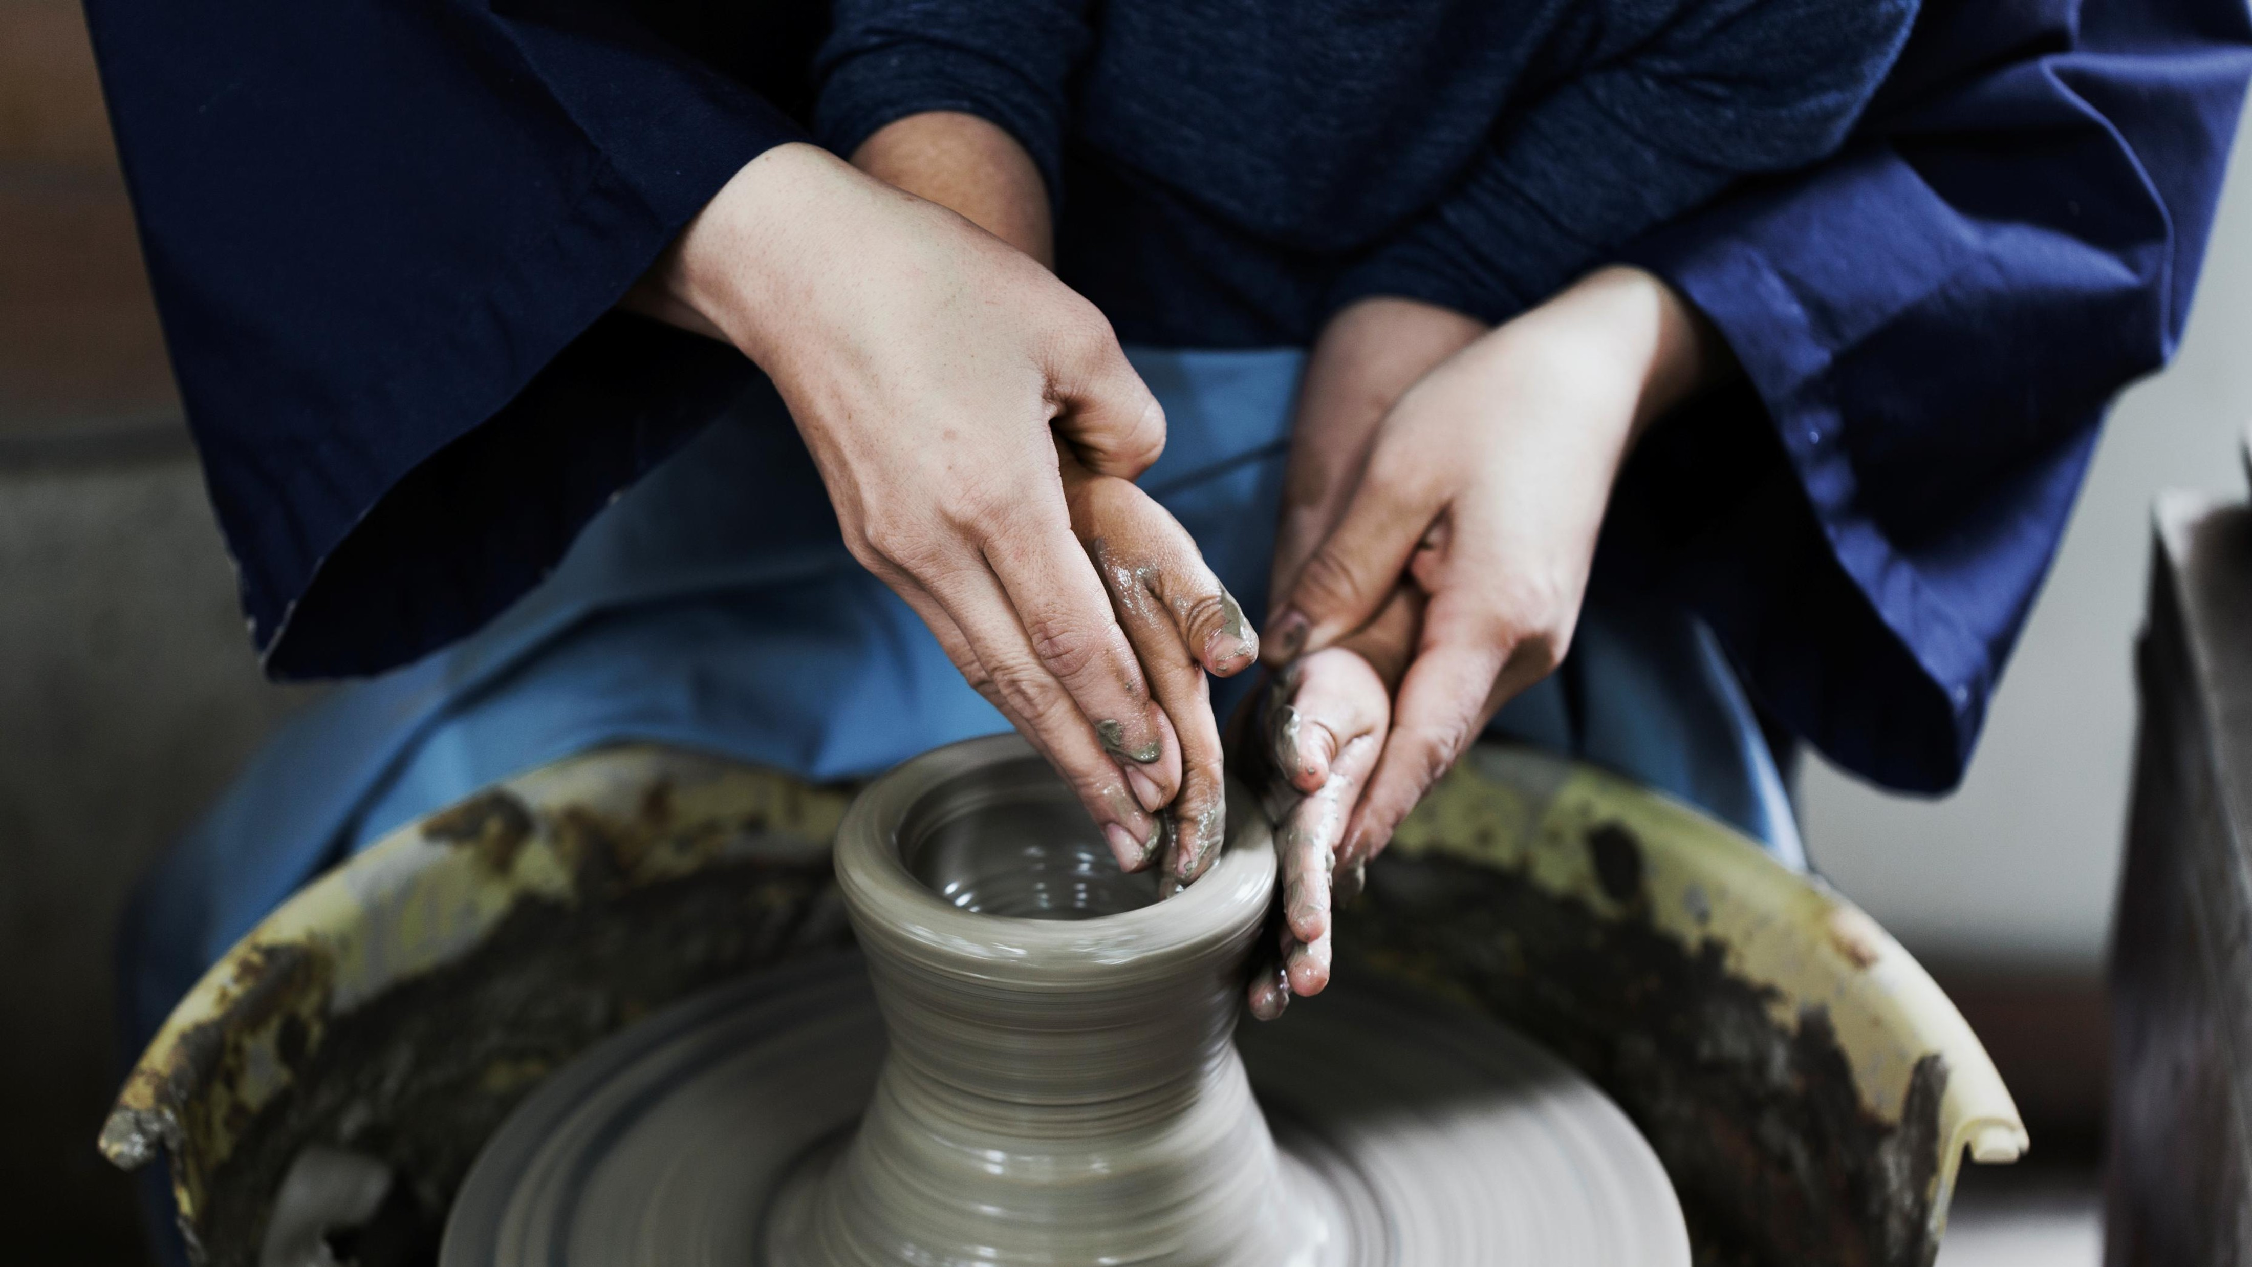







Centering Ourselves
Remembering the ways you honor people or moments when you have been honored
Notes:
Center our selves – mindf
https://www.youtube.com/watch?v=XDCJsJmstlkulness

Slide 2
30 years of this beloved community
Notes:
Center our selves – mindf
https://www.youtube.com/watch?v=XDCJsJmstlkulness

Slide 3
Generations of Integrated Care Professionals
A special welcome to our first time attendees.
Welcome to the family
Notes:
Center our selves – mindf
https://www.youtube.com/watch?v=XDCJsJmstlkulness

Slide 4
So, what do you do when special people move you, and you are spiritually compelled to honor them?
Notes:
Center our selves – mindf
https://www.youtube.com/watch?v=XDCJsJmstlkulness

Slide 5
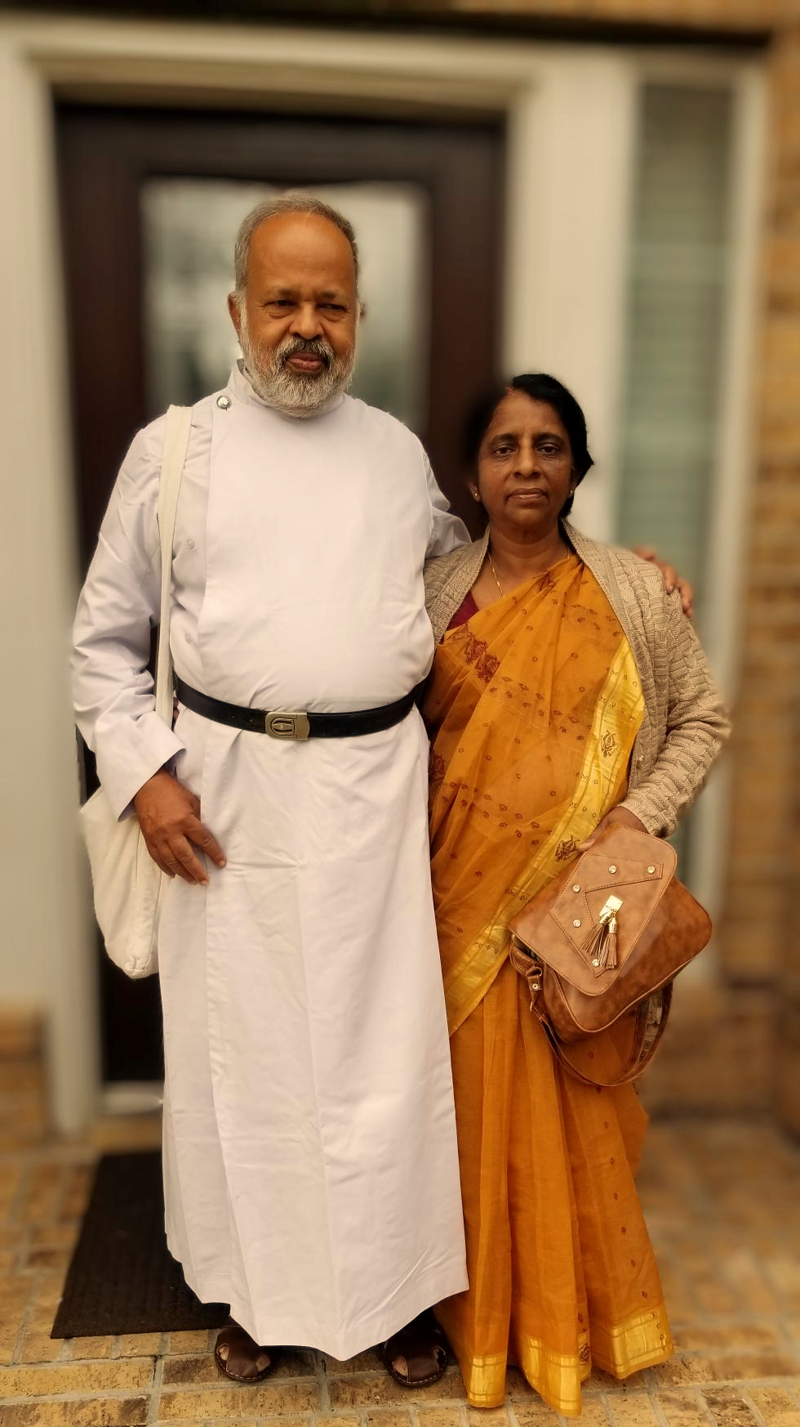
The
Luminaries of CFHA
Notes:
Center our selves – mindf
https://www.youtube.com/watch?v=XDCJsJmstlkulness

Slide 6
Celebrating you as a CFHA Luminary
October 2024
San Antonio, TX
Notes:
Center our selves – mindf
https://www.youtube.com/watch?v=XDCJsJmstlkulness

Slide 7
The institution of the family has profoundly and resiliently changed over the past thirty-plus years.
Calibrate cohesion and flexibility throughout their lifecycle stage as a unit to form and nurture healthy individuals who can reasonably differentiate to make choices of their own.
Notes:
Center our selves – mindf
https://www.youtube.com/watch?v=XDCJsJmstlkulness

Slide 8
CFHA functioned more as a Family - stable professional home base/unit to launch many differentiated ideas and individuals into the world to transform the world around us, while still remaining connected
Notes:
Center our selves – mindf
https://www.youtube.com/watch?v=XDCJsJmstlkulness

Slide 9
….members over functioned to return us to stability
…young children, we had sibling rivalries between models
Notes:
Center our selves – mindf
https://www.youtube.com/watch?v=XDCJsJmstlkulness

Slide 10
Metaphor of a greenhouse
A developmental marker of our ongoing maturity and differentiation
Notes:
Center our selves – mindf
https://www.youtube.com/watch?v=XDCJsJmstlkulness

Slide 11
Much like we all need our families, we also need a professional family – a functional relational system to help us see ourselves, nurture each other, so that we may be more fruitful when we return to our places of work.
Notes:
Center our selves – mindf
https://www.youtube.com/watch?v=XDCJsJmstlkulness

Slide 12
Luminaries,
we are indebted to you and warmed by you.
Notes:
Center our selves – mindf
https://www.youtube.com/watch?v=XDCJsJmstlkulness

Slide 13

So, whoever you are and wherever you are in your journey of integration, fight for equity or just need a respite to recharge your souls –
Welcome home.
Welcome to

