Slide 1

Primary Care Providers’
Practices Regarding Patient Sleep:
Impact of Integrated Behavioral Health
Research Corner
6/3/2024
Golden, M. E., Cosottile, M., Meadows, T., Parikh, M. R., & O'Dell, S. M. (2023). Primary care
providers’ practices regarding patient sleep: Impact of integrated behavioral health. Families,
Systems, & Health, 41(2), 192–200. https://doi.org/10.1037/fsh0000695

Slide 2
Background
While many children and adolescents experience sleep issues, research indicates pediatric providers rarely screen for, diagnose, and treat sleep concerns.
No research has examined whether PCPs who practice in IPC are more likely to assess sleep concerns than PCPs without IPC.
The current study aimed to examine providers’ current practices and knowledge regarding common sleep topics from clinics with and without IPC.
Notes:
sleep issues (bedtime problems, insomnia, and night waking)

Slide 3
Method
Participants included 101 PCPs across a large health system of 38 clinics:
  IPC clinics (n = 67)
  Non-IPC clinics (n = 34)
Most participants identified as White females in their 30s, MDs or DOs, and were either 20+ years post residency or had completed their residency in the past 5 years.
Participants responded to questions regarding current sleep assessment and intervention practices, general sleep, and medications knowledge.

Slide 4
Results
PCPs in both IPC and non-IPC reported moderate comfort with behavioral interventions, low comfort with medical interventions, and had low medication knowledge scores.
While PCPs in both settings recognized the importance of addressing sleep-related concerns, IPC clinics were 3.58 times more likely to screen for snoring than non-IPC clinics.
Notes:
Medication knowledge - many providers did not know whether Clonidine or Trazadone were effective, and approved treatments for insomnia in children.

Slide 5
Conclusion
PCPs in both IPC and non-IPC have room for improvement in their knowledge of effective behavioral and medication interventions.
Integrating BHPs into primary care offices can enhance PCPs' knowledge and comfort with behavioral interventions, particularly for the assessment and treatment of sleep concerns.
BHPs can facilitate training and work collaboratively with PCPs to improve patient access to sleep interventions.
Having a BHP was associated with higher rates of screening for snoring and patient access to evidence-based interventions for obstructive sleep apnea (OSA).

Slide 6
Sleep Well! An adapted behavioral
sleep intervention implemented
in urban primary care
Research Corner
6/3/2024
Williamson, A. A., Okoroji, C., Cicalese, O., Evans, B. C., Ayala, A., Harvey, B., Honore, R.,
Kratchman, A., Beidas, R. S., Fiks, A. G., Power, T. J., & Mindell, J. A. (2022). Sleep Well! An
adapted behavioral sleep intervention implemented in urban primary care. Journal of Clinical
Sleep Medicine, 18(4), 1153–1166. https://doi.org/10.5664/jcsm.9822

Slide 7
Background
Few evidence-based behavioral sleep interventions have been tested with families from lower–socioeconomic status backgrounds.
To address this gap, community-engaged research methods were used to adapt and test Sleep Well!, an intervention for early childhood insomnia and insufficient sleep, specifically designed for families from lower–socioeconomic status backgrounds visiting large metropolitan primary care sites.

Slide 8
Method
Fifteen caregiver-child dyads were recruited from 2 urban primary care sites to participate in Sleep Well!
  Caregivers: 92.3% mothers, 80.0% Black, 53.3% ≤ 125% US poverty level
  Children: 73.3% female, 86.7% Black, mean age = 3.0 years
Inclusion criteria:
  (1) English-speaking caregiver, aged 18 years or older, who was the legal guardian of a child aged 1–5 years receiving care at the urban primary care sites;
  (2) a caregiver reported “small” to “severe” child sleep problem;
  (3) child met diagnostic criteria for pediatric insomnia or insufficient sleep;
  (4) child did not have a diagnosed medical (e.g., sickle cell disease, cancer) or neurodevelopmental (e.g., autism, Trisomy 21) condition that would impact sleep
Notes:
Most participating caregivers were Black (80.0%) mothers (92.3%) with a young child aged 3.00 years, on average.
The majority of the children were Black (86.7%) girls (73.3%).
Half (53.3%) of the families were living at or below 125% of the US poverty level.

Slide 9
Method
Behavioral sleep interventions and recommendations:
  (1) psychoeducation (sleep duration guidelines and importance of sleep for young children)
  (2) sleep hygiene (consistent bedtime routine; bedtime before 9:00 PM; avoidance of caffeine; avoidance of electronic items 30–60 minutes before bedtime, at sleep onset, and overnight)
  (3) differential reinforcement for bedtime tantrums (ignoring minor misbehaviors, praise and/or tangible rewards for good bedtime behaviors)
  (4) methods to promote independent child sleep onset (gradually reducing caregiver presence at bedtime).
Sleep Well! adapted the above strategies based on qualitative input from caregivers (n=4) and clinicians (n=13)

Slide 10
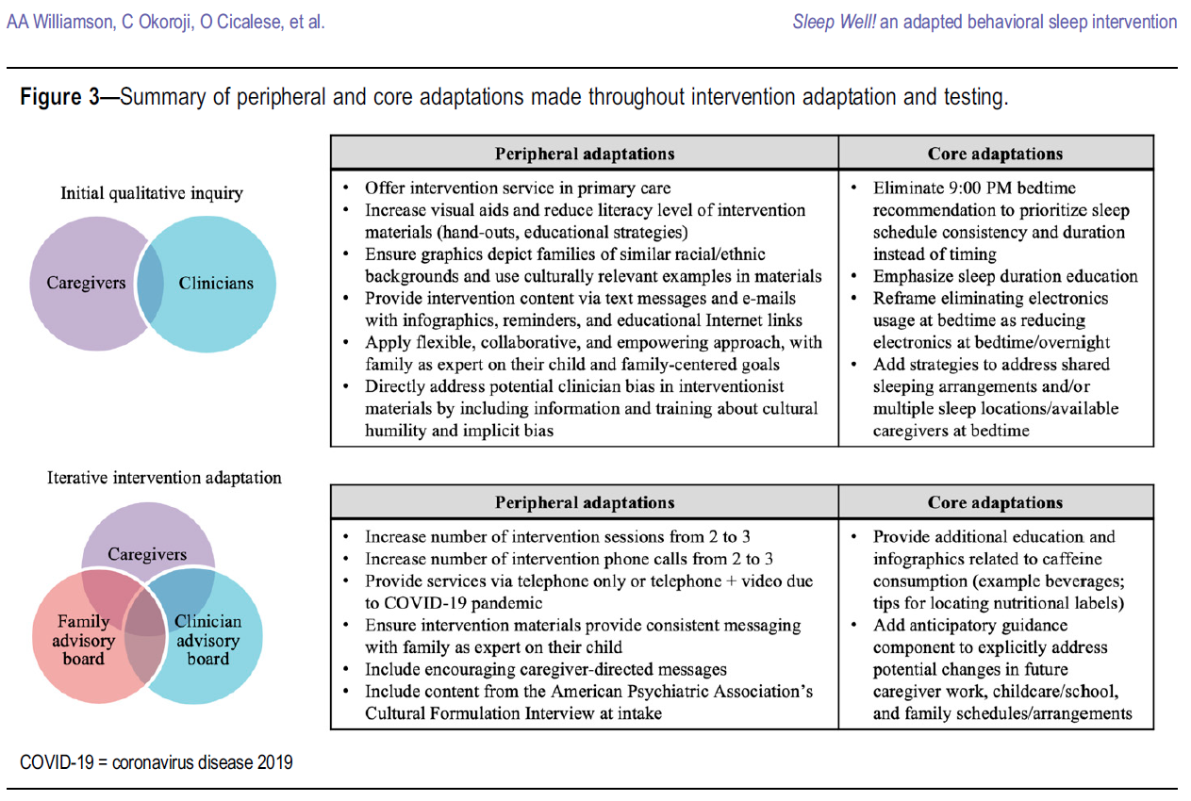
Method
Notes:
Sleep Well! adapted the above strategies based on qualitative input from caregivers and clinicians
Peripheral adaptations (intervention delivery)
Core adaptations (intervention strategies)
They eliminated explicit references to an “early” bedtime before 9:00 PM based on qualitative feedback that altering bedtime was challenging for caregivers with rotating/shift work schedules or competing child care demands.26 Instead, we emphasized education about the importance of total (24-hour) sleep duration and sleep time regularity across weekdays and weekends.

Slide 11
Method
Feasibility
  Retention and family engagement
Acceptability
  Treatment Evaluation Inventory- Short Form, adapted for Sleep Well!
    “I found the sleep intervention strategies to be acceptable.”
Cultural humility
  Multicultural Therapy Competency Inventory-Client Version
    Included questions about whether the caregivers felt they were treated with respect and the extent to which the interventionist was open to and understanding of the caregivers’ beliefs.
Child sleep
  Brief Child Sleep Questionnaire
    Early childhood sleep patterns (bed- and wake times, sleep onset latency, nighttime and daytime sleep durations), problems (difficulty falling asleep, bedtime resistance), and aspects of the sleep environment (use of a bedtime routine, sleep arrangements/locations).
Postintervention caregiver interview
  Caregivers participated in a 30-minute semistructured postintervention interview

Slide 12
Results
Feasibility
  13 of the 15 families (86.6%) completed all intervention components of Sleep Well!
Acceptability
  Strong
Cultural humility
  Strong
Child sleep
  Significant reductions in child sleep problems, bedroom electronics, sleep onset latency, and night awakening frequency and duration
  Significant improvements in nighttime sleep duration and overall insufficient sleep
Postintervention caregiver interview
  Strong acceptability and perceived flexibility, with few participation barriers
Notes:
Acceptability
All (100%) caregivers agreed or strongly agreed that the intervention was acceptable and that they liked the strategies, would use them in the future, and felt positively about the strategies overall. No families reported feeling uncomfortable with the strategies, and most agreed or strongly agreed that the strategies would result in permanent change (83.0%) and were effective (91.0%).
Cultural humility
(100%) caregivers agreed or strongly agreed that they were treated respectfully, that their family’s values and beliefs were accepted, that there was openness to the caregiver’s point of view, and that there was appreciation of the caregiver’s expertise. Most (90.0%) agreed or strongly that their family’s culture and background were understood.
Few participation barriers
Because of overnight or inflexible caregiver work schedules or multiple sleep environments (e.g., different caregiver homes, babysitter’s home)

Slide 13
Conclusion
Findings suggest that Sleep Well! is highly feasible to implement in primary care and well-received by families, demonstrating cultural humility and improving child sleep in a sample of caregiver-child dyads from primarily lower socioeconomic status and/or racially minoritized backgrounds.
Sleep Well! shows promise as an effective method for increasing access to sleep treatment and promoting pediatric sleep health equity.

