Slide 1

Understanding and Promoting Healthy Sleep in Integrated Care
Tori Van Dyk, PhD
Associate Professor
Department of Psychology
Loma Linda University

Slide 2
Objectives
Discuss the ways in which biology, behavior, environment, and society impact healthy sleep.
Implement strategies to briefly and effectively assess for sleep problems.
Describe evidence-based interventions to optimize sleep in youth.

Slide 3
Understanding Sleep
Sleep Development

Slide 4
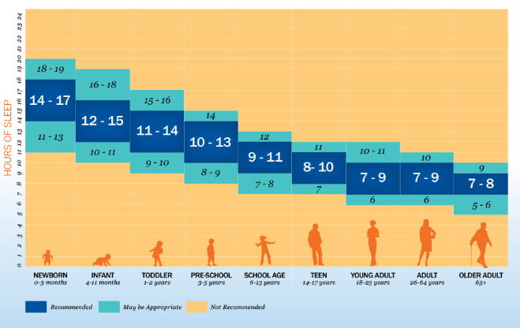
Sleep Duration Recommendations
(Hirshkowitz et al., 2015)

Slide 5
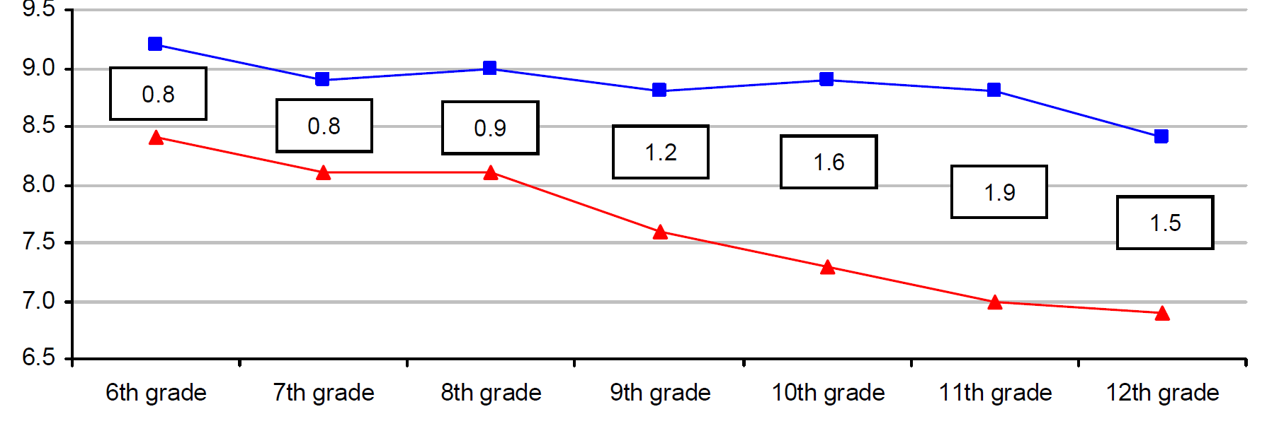
How much do kids report sleeping?
Clinical Recommendation
Non-School Nights
Clinical Recommendation
School Nights
(National Sleep Foundation 2006 Sleep in America Poll; National Sleep Foundation 2015 Recommendations)
(NSF, 2006)
Notes:
Vast majority of teens (around 80%) receive sub-optimal sleep (on average should get 9 hours)
6th-8th graders should be getting an average of 10 hours of sleep

Slide 6
How common are sleep problems in youth?
~25% of children have sleep problems
25-50% in preschool aged samples
37% in community sample of 4-10 year olds
Upward of 40% in adolescents
Problems up to 6 times more common in youth clinical populations
30% entering mental health treatment
(Liu et al., 2005; Reigstad et al., 2010)

Slide 7

Why is sleep important?
Related (often causally) with most aspects of wellbeing.

Slide 8
Understanding Sleep

Slide 9

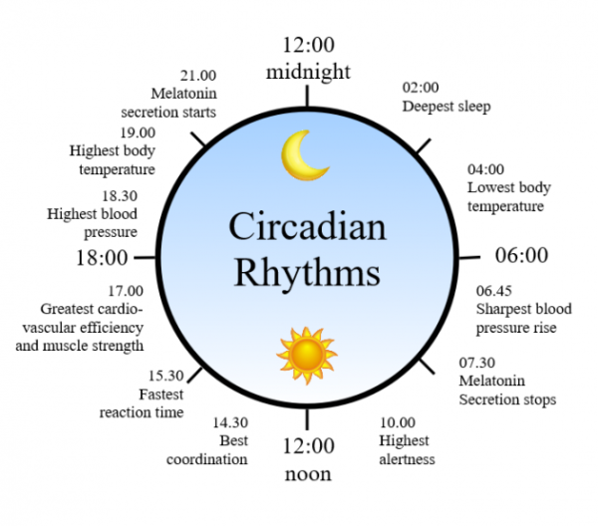

Components of Sleep
Behavioral
Things we do (behavior)
Decreased responsiveness and interaction with external stimuli
Biological
Things are body does (that we can change with our behavior)
Endogenous circadian rhythm (biological clock)
Homeostatic process (sleep drive – battery)

Slide 10
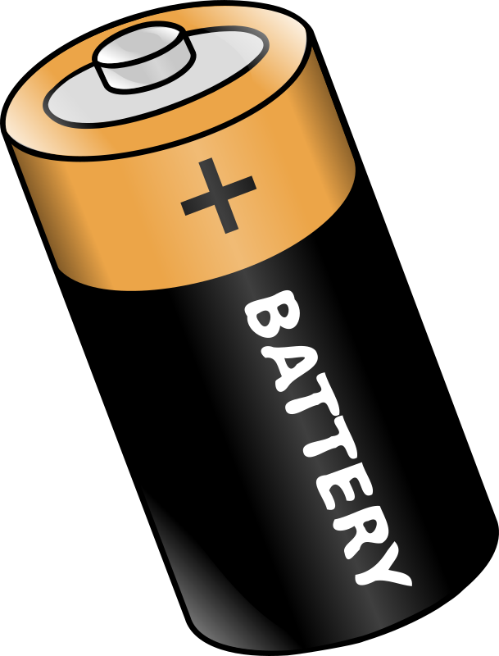

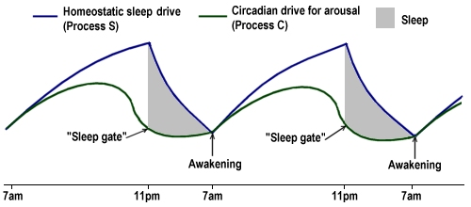
Two Process Theory of Sleep
(Borbely & Achermann, 1999; Mastin, 2013)
Notes:
Two primary processes:
-Endogenous circadian rhythm (i.e., biological time clock): internal process that directs the timing and duration of daily sleep-wake cycles
-Homeostatic Process: Independent of the circadian rhythm, regulates the length and depth of sleep as a function of the timing, duration, and quality of an individual’s previous sleep period
***This is important because disruption to either one of these processes can alter sleep.

Slide 11
What can disrupt these processes?
Homeostatic Sleep Drive (Battery)
Circadian Drive for Arousal (Bio Clock)
Oversleeping
Napping
Teens/young adults have a slower build of “sleep pressure”
Caffeine
Puberty
Later melatonin secretion
Zeitgebers (external cues)
Light, temperature, exercise, eating/drinking, social interaction
Staying up late, sleeping in

Slide 12
Other Influences on Sleep
Brain regions, hormones, neurotransmitters
Environmental & Social
Can “override” biological influences
Sleep associations
Emotional & Psychological Health
Physical Environment
Racial/Ethnic Disparities (e.g., discrimination)

Slide 13
Assessment
How to diagnose sleep problems

Slide 14
Chronic Insomnia Disorder – DSM-5
The patient or caregiver observes one or more:
Difficulty falling asleep
Difficulty maintaining sleep
Waking earlier than desired
Resistance going to bed
Difficulty sleeping without a caregiver
Related to the sleep difficulty, one or more:
Fatigue/malaise
Attention, concentration, memory problems
Social, family, occupational, academic problems
Mood disturbance/irritability
Daytime sleepiness
Behavioral problems
Reduced motivation/energy/initiative
Proneness for errors/accidents
Concerns about/dissatisfaction with sleep
Not just explained by inadequate sleep opportunity or environment
Symptoms 3x/week for at least 3 months
Not explained by another sleep disorder

Slide 15
Chronic Insomnia Disorder – DSM-5
Difficulty falling asleep, staying asleep, waking up too early, or resistance to bedtime.
The patient or caregiver observes one or more:
Difficulty falling asleep
Difficulty maintaining sleep
Waking earlier than desired
Resistance going to bed
Difficulty sleeping without a caregiver
Related to the sleep difficulty, one or more:
Fatigue/malaise
Attention, concentration, memory problems
Social, family, occupational, academic problems
Mood disturbance/irritability
Daytime sleepiness
Behavioral problems
Reduced motivation/energy/initiative
Proneness for errors/accidents
Concerns about/dissatisfaction with sleep
Not just explained by inadequate sleep opportunity or environment
Symptoms 3x/week for at least 3 months
Not explained by another sleep disorder
2. Results in daytime problems.
Subclinical symptoms matter!
3. Patient has a safe, comfortable sleep environment and is allowed enough time to sleep.

Slide 16

Brief Sleep Assessment
Bedtime Excessive Sleepiness Awakenings Regularity and duration Snoring
(Owens & Dalzell, 2005)
Notes:
Development of a brief, simple pediatric sleep screening instrument that could be used in primary care settings (generalizable to other medical clinics). Shown to be effective in identifying sleep concerns.
These domains are meant to cover the most common sleep complaints in children.

Slide 17
Bedtime
→ Do you have difficulty going to bed and/or falling asleep?
Excessive Sleepiness
→ Do you feel sleepy (not fatigued) during the day? Do you need a nap? Do you wake up feeling refreshed?
Awakenings
→ Do you wake up during the night and have trouble going back to sleep?
Regularity and duration
→ Do you go to bed and wake up around the same time? Do you get enough sleep?
Snoring
→ Do you snore? Dry mouth? Mouth breathing? Morning headache?

Slide 18
Sleep Interventions

Slide 19
Components of Cognitive Behavioral Therapy for Insomnia (CBT-I)
Sleep Psychoeducation
Sleep Hygiene
Stimulus Control
Sleep Restriction/Sleep Compression
Relaxation
Cognitive Therapy

Slide 20
Sleep Psychoeducation
What is normal sleep?
Sleep duration and timing
Basic biology of sleep – night awakenings are normal (but can be a problem)
Sleep Environment
Cool, dark, comfortable, free from distractions
Sleep Hygiene
No TV 30-60 minutes before bedtime; no caffeine
~30% of preschoolers and 43% of school age kids have TVs in their bedrooms
~27% of preschoolers and 41% of school age kids have at least 1 caffeinated drink/day

Slide 21
More Sleep Hygiene
Avoid caffeine after 3pm
Avoid smoking, drugs, alcohol
Regular exercise is helpful, but not right before bed
Minimize noise, light, sound
Sleep in a cool room
Avoid screens before bed
Exposure to sunlight, especially in morning (open blinds!)

Slide 22
Establishing Basics: Schedules, Routines, & Environment
Consistent and appropriate sleep schedule
Don’t vary by more than 1 (maybe 2) hours
Bedtime routine
~30 minutes of the same activities in the same order
Try to end in bedroom, reward each step (if needed), avoid stimulating activities (screens), baths can be a good start
Sleep Environment
Independent sleep space (if possible)

Slide 23

Stimulus Control
When to use:
Person spends a significant amount of time in bed awake
Why it works:
Conditioned arousal
Time spent in bed heightens arousal, anxiety, frustration
Tired (fatigued) vs. Sleepy – important distinction!
“The earlier I go to bed, the earlier I will fall asleep.”

Slide 24
Stimulus Control - Steps
Go to bed only when sleepy (not tired)
Use the bed/bedroom only for sleeping
No reading, work, TV, etc.
Reconditioning the stimulus response to bed = sleep
Implications for those with chronic illness, physical limitations
Get out of bed when unable to sleep
After 15-20 minutes, go to another room and engage in quiet activity
Prolonged waking at night – same thing
Arise at the same time every morning, regardless of sleep
No naps!

Slide 25
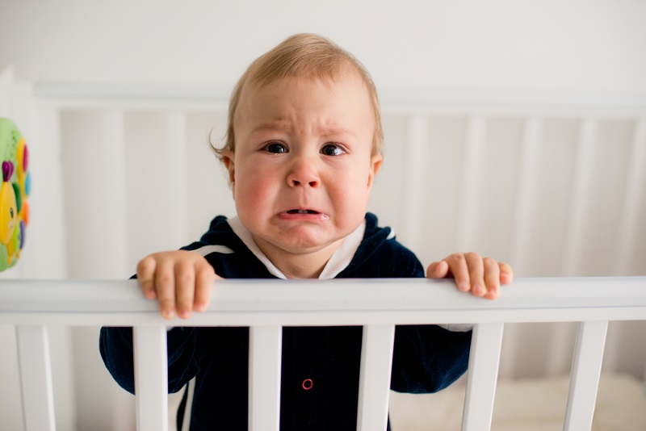
Sleep Associations
Many kids need something (most commonly someone… parent) to fall asleep. These are called sleep associations.
Have to teach the child to fall asleep independently. Options:
Unmodified Extinction (“Cry it out”)
Quickest, most effective but hardest on parents
Graduate Extinction
Parent returns at regular intervals
Extinction with Parent Presence
Remain in room but ignore
Parent Fading
Gradually increase distance from child

Slide 26
Will this hurt my child?
In short, no.
No research to support harm in sleep training that involves crying.
Immediately following sleep interventions, infants are:
More secure
More predictable
Less irritable
Cry less
No negative impact on breastfeeding (can sleep train and breastfeed)
5 year longitudinal study (Price et al., 2012) – no negative effects on:
Child mental health, psychosocial functioning, stress regulation
Parent-child relationship, closeness, attachment
Parental mental health or parenting styles
(Price et al., 2012)

Slide 27
In sum…
Sleep is important
Kids/teens don’t get enough
Sleep problems are common
We know how to fix them!
Behavioral health specialists are especially good at this

Slide 28
Thank you!
Questions:
Tori Van Dyk
tvandyk@llu.edu

Slide 29
References
Hirshkowitz, M., et al. (2015). "National Sleep Foundation’s updated sleep duration recommendations." Sleep Health: Journal of the National Sleep Foundation 1(4): 233-243.
National Sleep Foundation (2006, 2010, 2018, 2019). Summary of Findings: Sleep In America Poll. Washington, DC, National Sleep Foundation.
Liu, X., Liu, L., Owens, J. A., & Kaplan, D. L. (2005). Sleep patterns and sleep problems among schoolchildren in the United States and China. Pediatrics, 115(Supplement 1), 241-249.
Reigstad, B., et al. (2010). "Prevalences and correlates of sleep problems among adolescents in specialty mental health services and in the community: What differs?" Nordic Journal of Psychiatry 64(3): 172-180.
Morin, C. M. (2004). Cognitive-behavioral approaches to the treatment of insomnia. Journal of Clinical Psychiatry, 65, 33-41.
Bhaskar, S., Hemavathy, D., & Prasad, S. (2016). Prevalence of chronic insomnia in adult patients and its correlation with medical comorbidities. Journal of family medicine and primary care, 5(4), 780.
Beebe, D. W. (2011). "Cognitive, behavioral, and functional consequences of inadequate sleep in children and adolescents." Pediatr Clin North Am 58(3): 649-665.
Beebe, D. W., et al. (2008). "Feasibility and behavioral effects of an at-home multi-night sleep restriction protocol for adolescents." Jn Child Psychol Psychiatry 49: 915-923.
Beebe, D. W., et al. (2007). "Sleep in Overweight Adolescents: Shorter sleep, poorer sleep quality, sleepiness, and sleep-disordered breathing." Journal of pediatric psychology 32: 69-79.
Fatima, Y., et al. (2015). "Longitudinal impact of sleep on overweight and obesity in children and adolescents: a systematic review and bias-adjusted meta-analysis." Obes Rev 16(2): 137-149.
Könen, T., et al. (2015). "Cognitive benefits of last night's sleep: Daily variations in children's sleep behavior are related to working memory fluctuations." Journal of Child Psychology and
Meltzer, L. J., et al. (2015). "Experimentally manipulated sleep duration in adolescents with asthma: Feasibility and preliminary findings." Pediatric Pulmonology 50(12): 1360-1367. Psychiatry 56(2): 171-182.

Slide 30
References
Van Dyk, T. R., et al. (2018). "Mental Health Diagnoses and Symptoms in Preschool and School Age Youth Presenting to Insomnia Evaluation: Prevalence and Associations with Sleep Disruption." Behav Sleep Med: 1-14.
Van Dyk, T. R., et al. (2019). "Rates of mental health symptoms and associations with self-reported sleep quality and sleep hygiene in adolescents presenting for insomnia treatment." Journal of Clinical Sleep Medicine 15(10): 1433-1442.
Van Dyk, T. R., et al. (2016). "Daily Bidirectional Relationships Between Sleep and Mental Health Symptoms in Youth With Emotional and Behavioral Problems." J Pediatr Psychol.
Van Dyk, T. R., et al. (2017). "Feasibility and Emotional Impact of Experimentally Extending Sleep in Short-Sleeping Adolescents." Sleep 40(9): zsx123-zsx123.
Borbely, Alexander A., and Peter Achermann. "Sleep homeostasis and models of sleep regulation." Journal of biological rhythms 14.6 (1999): 559-570.
National Institute of Neurological Disorders and Stroke (2019). Brain basics: Understanding sleep. Retrieved from: https://www.ninds.nih.gov/Disorders/Patient-Caregiver-Education/Understanding-Sleep#1
Drummond, S. P., Walker, M., Almklov, E., Campos, M., Anderson, D. E., & Straus, L. D. (2013). Neural correlates of working memory performance in primary insomnia. Sleep, 36(9), 1307-1316.
Mistlberger, R. E., & Skene, D. J. (2004). Social influences on mammalian circadian rhythms: animal and human studies. Biological Reviews, 79(3), 533-556.
Carskadon, M. A. (2011). Sleep in adolescents: the perfect storm. Pediatric Clinics, 58(3), 637-647.
Grandner, M. A., Williams, N. J., Knutson, K. L., Roberts, D., & Jean-Louis, G. (2016). Sleep disparity, race/ethnicity, and socioeconomic position. Sleep Medicine, 18, 7-18.
Boulos, M. I., Jairam, T., Kendzerska, T., Im, J., Mekhael, A., & Murray, B. J. (2019). Normal polysomnography parameters in healthy adults: a systematic review and meta-analysis. The Lancet Respiratory Medicine, 7(6), 533-543.

Slide 31
References
Owens, J. A. and V. Dalzell (2005). "Use of the ‘BEARS’sleep screening tool in a pediatric residents' continuity clinic: a pilot study." Sleep medicine 6(1): 63-69.
Mindell, J. A., Kuhn, B., Lewin, D. S., Meltzer, L. J., & Sadeh, A. (2006). Behavioral treatment of bedtime problems and night awakenings in infants and young children. Sleep, 29, 1263-1276.
Meltzer, L. J., & Mindell, J. A. (2014). Systematic review and meta-analysis of behavioral interventions for pediatric insomnia. Journal of Pediatric Psychology, 39, 932-948.
Morin, C. M., Bootzin, R. R., Buysse, D. J., Edinger, J. D., Espie, C. A., & Lichstein, K. L. (2006). Psychological and behavioral treatment of insomnia: update of the recent evidence (1998–2004). Sleep, 29(11), 1398-1414.
Morin, C. M. (2004). Cognitive-behavioral approaches to the treatment of insomnia. J Clin Psychiatry, 65(Suppl 16), 33-40.
Wu, J. Q., Appleman, E. R., Salazar, R. D., & Ong, J. C. (2015). Cognitive behavioral therapy for insomnia comorbid with psychiatric and medical conditions: a meta-analysis. JAMA internal medicine, 175(9), 1461-1472.
Schutte-Rodin, S., Broch, L., Buysse, D., Dorsey, C., & Sateia, M. (2008). Clinical guideline for the evaluation and management of chronic insomnia in adults. Journal of clinical sleep medicine, 4(5), 487-504.
Price, A. M., Wake, M., Ukoumunne, O. C., & Hiscock, H. (2012). Five-year follow-up of harms and benefits of behavioral infant sleep intervention: randomized trial. Pediatrics, 130(4), 643-651.

