Slide 1
Medical Families at risk
Hernan Barenboim, PhD, LMFT

Slide 2
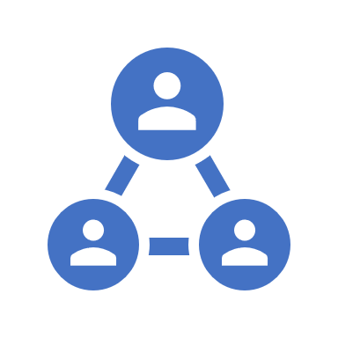
Objectives
By the end of this presentation, participants will be able to:
1. List common personality traits of physicians, spouses, and children.
2. Describe three family therapy techniques to run psychotherapy sessions with medical families.
3. Analyze a clinical case and propose family-oriented treatment plans.

Slide 3

Medical Families
“Families where at least one member is a physician”

Slide 4
Intro
Lack of research about these families
Particular family dynamics
Financial factor
Society prestige

Slide 5
Ada’s family
Notes:
Explain phone call
“Joan is the problem,” and I don’t know what's happen to her
Jeff cannot even speak about his parents without intense emotional reactions

Slide 6
What factors take your attention? (think about generational patterns and genders related to the medicine

Slide 7
Family of doctors
Tradition
The medical culture
Doctor parents prone to have doctor children

Slide 8
First session
Mom got 15 minutes late due to issues at the hospital.
Father, brother, and Joan (identified patient) in the waiting room.
I asked to re-schedule and Joan stated “This happen all the time, let’s wait”
Father did most of the talking when we went to the room
Patients’ problems with school, friends and family.
Identified patient not talking at all but clearly uncomfortable
Refused to talk
By the end of the session, Ada asked me to speak alone
Explained my no secret police, and we schedule a time the next day for an app.
Notes:
Spent a couple of minutes with Joan alone, she spoke a little but I understood she did not fell it safe yet.

Slide 9
2d session individual Mom
She feels that her family is a “mess.”
She defined her life as a “perfect storm.”
When in the hospital, feels guilty for the lack of family time,
When with family feels guilt for the team at the hospital (more in recent times because they have several positions not covered)
She is working around 65 to 70 hrs a week, sometimes with no sleeping

Slide 10
What thoughts do you have about this session?

Slide 11
Feminization of medicine
1990
20 % morer females in 2018 than in 1990
2017
Since 2017, the number of female medical students is higher than men

Slide 12
Physician women
Several more demands than male physicians:
Family planning
Pregnancy
Raising children
Work-life integration
Significant inequities
Biases – more targets of microaggressions

Slide 13
As a result,…
Female Physicians Suffering is in silence

Slide 14
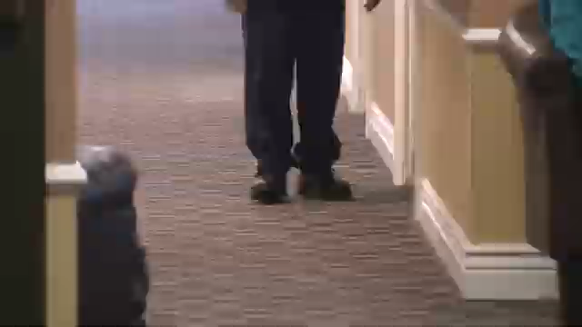

Slide 15
3rd session (parents)
Met when Ada was in residency
Jeff was at this point in her first position as CFO in a big company
After 3 different positions as CEO, he was fired for legal problems for having sex with several subordinate females in her team.
Since then, he defines himself as “a home dad” to take care of children and save his marriage
Not marriage therapy – important Cristian base belief system
No intimacy for 3 years, and important decline after the discovery of reiterative affairs.
No emotional reaction from Ada about this.
Jeff does not believe family is a mess. He thinks that she is not so much at home to evaluate for that.
Both of them came from families where moms stayed at home as principal caregiving figures.
Most infidelities happened during the transition from residency to a full-time ER job.

Slide 16
Why do you think most infidelities happen during the first Ada’s full-time position as an ER physician?

Slide 17
Significant other
30 % report burnout
Invisibility
Feeling lonely
No couple-time
Caregiving responsibilities
Housekeeping responsibilities

Slide 18
Medical marriages
Let’s define what support means for the physician partner.
The higher moral dilemma
Contradictory findings about physician's divorce rate
Satisfaction problems

Slide 19
When both are doctors…
Marriage satisfaction is higher
There are more values in accordance
More sense of empathy
More external help for parenting

Slide 20
4th session - Family
Jeff, Ada, Joan, and Mike present
New problems at school
Ada was very critical of Joan
Jeff was trying to decrease the conflict

Slide 21
Children of medical families
High achievers' mindset
Independence
Loneliness
Role confusion
Model of sacrifice
And…You never are going to believe any medical tv show again…

Slide 22
The voices of children
“As a child, my father (a surgeon) was almost never at home; to see him was weird (almost a privilege). I stole his stethoscope to have something of him close to me when it was difficult to sleep at night.”
“I don’t want a doctor; I want a mom.”
“What is more important to you, your patients, or me?”

Slide 23

So, what is going on with our doctors?

Slide 24


Slide 25
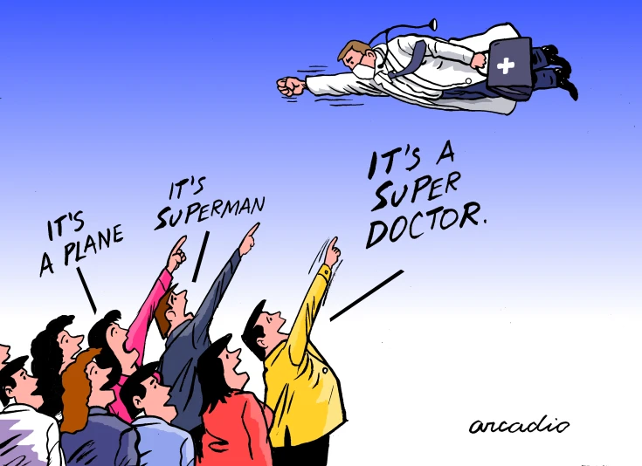

Slide 26


Slide 27
The burnout epidemic
63 % of doctors reported stress and burn out
55 % are considering to leave the profession in the next 2 years

Slide 28
But why?
Lack of life/work balance
Unrealistic demands
Chaotic healthcare

Slide 29
Corporative medicine
Patient care
Profit maximization

Slide 30

“While burnout manifests in individuals, it originates in systems”
Chirstine Sinsky, MD

Slide 31
Healthcare system
Chaotic systems
Toxic relationships
Heavy individualistic perspective
Business & legal Orientation – transactional orientation
No space for emotional processing

Slide 32
Moral Injuries
“perpetrating, failing to prevent, bearing witness to, or learning about acts that transgress deeply held moral beliefs and expectations.”

Slide 33
And…
No so many options for non-for-profit work
Private practices involve even more administrative work
For primary care health centers generally involve high number of patients – challenging to develop longitudinal relationships

Slide 34
As a result,…
It is difficult to find joy in the job

Slide 35
Family Assessment
Monopolization of talking
Focus on understanding of moral standards of each member of the family and focus on dissonant values
How much the medical culture is part of the family conversations
What support means (by everyone)
Experiences of loneliness
Family history/medical studies/residency/work

Slide 36
Family cycle
Medical school
Family Losses/moves
Residency
Family Losses/moves
Family losses/moves
Work

Slide 37
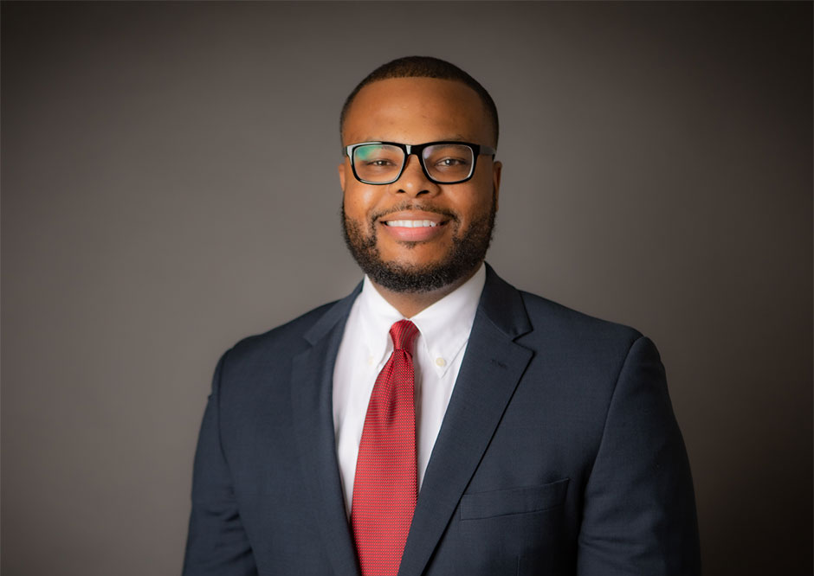
Dr Webb – spine surgeon and veteran
By far, medical school is more challenging than military training
The amount of expected knowledge acquisition is almost impossible for a normal human being to absorb

Slide 38

Residency
Same level of pressure & challenge
But they have some payment

Slide 39
Interventions

Slide 40
1. Addressing the higher moral value
Understand dissonant values.

Slide 41
2. Circularity is a must…
There is a multilevel causation of relational potential issues due the demands of the doctor’s life

Slide 42
3. Let’s talk about vulnerabilities
And after you did it once, bring it again, and then again…

Slide 43
4. Identify doctor emotions
Tendency to a hyper-logical, scientific type of conversation
Short, to the point, and with minimal post development
Address the role of emotions in developing healthy attachments for the family
After some time of attachment work, you potentially will see a change in the attachment style.

Slide 44
Reference
Baker, K., & Sen, S. (2016). Healing medicine’s future: prioritizing physician trainee mental health. AMA journal of ethics, 18(6), 604.
Carrieri, D., Briscoe, S., Jackson, M., Mattick, K., Papoutsi, C., Pearson, M., & Wong, G. (2018). ‘Care Under Pressure’: a realist review of interventions to tackle doctors’ mental ill-health and its impacts on the clinical workforce and patient care. BMJ open, 8(2), e021273.
Dyrbye, L. N., Shanafelt, T. D., Balch, C. M., Satele, D., & Freischlag, J. (2010). Physicians married or partnered to physicians: a comparative study in the American College of Surgeons. Journal of the American College of Surgeons, 211(5), 663-671.
Isaac, C., Petrashek, K., Steiner, M., Manwell, L. B., Byars-Winston, A., & Carnes, M. (2013). Male spouses of women physicians: communication, compromise, and carving out time. Qualitative Report (Online), 18, 1.
Myers, M. F., & Gabbard, G. O. (2008). The physician as patient: a clinical handbook for mental health professionals. Washington, DC, USA: American Psychiatric Pub..
Perlman, R. L., Ross, P. T., & Lypson, M. L. (2015). Understanding the medical marriage: physicians and their partners share strategies for success. Academic Medicine, 90(1), 63-68.
Shanafelt, T. D., Boone, S. L., Dyrbye, L. N., Oreskovich, M. R., Tan, L., West, C. P., ... & Sotile, W. M. (2013, March). The medical marriage: a national survey of the spouses/partners of US physicians. In Mayo Clinic Proceedings (Vol. 88, No. 3, pp. 216-225). Elsevier.
Smith, C., Boulger, J., & Beattie, K. (2002). Exploring the dual-physician marriage. Minnesota medicine, 85(3), 39-43.
Sotile, W. M., & Sotile, M. O. (2000). The medical marriage: sustaining healthy relationships for physicians and their families. American Medical Association.
Stanton, J., & Randal, P. (2016). Developing a psychiatrist–patient relationship when both people are doctors: a qualitative study. BMJ open, 6(5), e010216.
Woodward, C. A. (2005). When a physician marries a physician: effect of physician-physician marriages on professional activities. Canadian Family Physician, 51(6), 850-851.

