Slide 1

Financial Savviness for the BHC: Practical Strategies and Tips
Mary Jean Mork, LCSW
CFHA Webinar 5/23/19

Slide 2
Objectives
Participants will be able to:
Delineate the basic rules and regulations that guide fee for service billing and coding for behavioral health integration (BHI)
Identify key resources for support and information re: reimbursement
Identify some of the alternative methods of reimbursement or calculating “value” beyond basic fee for service billing
List key steps managers and leaders can take in creating and sustaining a business model that aligns with the clinical model for BHI

Slide 3

The Goal: Outcome driven, sustainable integrated practice model for patients and providers

Slide 4
10 Tips for Success
Know your service and business model
Learn the basics of billing, coding and reimbursement
Identify the other codes and where to get more information about these
Tie the reimbursement needs to the clinical service delivery
Organize your information – How about a grid?
Make friends with your billers and coders
Plan to get paid
Gather resources and keep learning
Be humble and persistently curious
Reframe the question

Slide 5
Official Disclaimer
Consultant makes no warranty regarding the manner in which any payor, governmental or private, will accept or deny any claim for reimbursement relating to integrated mental health services.
In publishing or otherwise disseminating any Work Product this author makes no representation or warranty regarding the manner in which any payor, governmental or private, will accept or deny any claim for reimbursement relating to integrated mental health services; that the provided is not intended to replace the information contained in the ICD-10-CM and CPT manuals or specific coding, reporting, or reimbursement information that may be disseminated by third-party or government payers; and that providers should seek advice from their own consultants with respect to submission of particular claims or categories of claims for reimbursement by payors.

Slide 6
Why Integration?
Behavioral health services in primary care, when appropriate, have positive impacts:
Increased adherence - to regimens and treatment of mental health disorders
  Unutzer et al, JAMA, 2002; Thota et al, Am. Journal of Prev. Med, 2012
Improved patient outcomes - clinical and functional
  Rost et al, JGIM, 2001; Simon et al, Psychological Medicine 1998; Unutzer et al, JAMA, 2002; Gilbody et al, Arch. IM 2006; Thota et al, Am. Journal of Prev. Med. 2012
Improved patient satisfaction with care
  Rost et al, JGIM, 2001; Unutzer et al, JAMA, 2002
Increased cost efficiency - including primary and specialty costs for physical health care
  Gilbody et al, British Journal of Psychiatry, 206; Katon et al, Arch Gen. Psych 2002; Katon et al, Diabetes Care, 2008; Unutzer et al, American Journal of Managed Care, 2008; Jacob et al, Am. Journal of Prev. Med. 2012

Slide 7

Tip #1 – Know your service and business model
Identify - Level of Integration
Identify - type of practice setting
Identify - who will do the billing

Slide 8
Levels of Integration
 |  | Level | Attributes | Reimbursement
Coordinated | Minimal Collaboration | I | Separate site & systems Minimal communication | Behavioral health clinician or agency bills No cost to med practice
 | Basic Collaboration at a distance | II | Active referral linkages Some regular communication | Behavioral health clinician or agency bills No cost to med practice
Co-Located | Basic Collaboration on site | III | Shared site; separate systems Regular communication | Behavioral health clinician or agency bills Space cost to med practice
 | Close Collaboration Onsite | IV | Shared site, some shared systems Routine communication and coordination | Behavioral health clinician or agency bills Med practice may support through contract or space
Integrated | Close Collaborative Approaching Integrated Practice | V | Shared site; shared systems Coordinated treatment plans Regular communication | Shared cost or med practice pays for service. Billing through med practice.
 | Full Collaboration in a Transformed Integrated Practice | VI | Shared site, vision, systems Shared treatment plans Regular team meetings Population based behavioral health | Med practice bills and pays for service

Slide 9


BHI is different
Notes:
9

Slide 10
Basic Models
Co-located - BHC individual or organization partners with medical practice and BHC bills
Integrated (Partially or Fully) - Medical practice contracts for or employs BHC and medical practice bills

Slide 11
The Questions for Integrated Care Settings
  Who will be delivering the service?
  What service will be delivered and what code will be used?
  Who are the partners doing integration?
  Where will the service be delivered?
  What is the “facility”? Under what license?
  Who will “employ” staff?
  Who will do the billing?
  How will the reimbursement work? Which insurance will be billed? What are the rules for that insurer?

Slide 12
Potential Partnerships (if BHC is not directly employed by medical setting)
Mental Health agency
Mental Health agency
Mental Health agency
Hospital Behavioral Health
Private MH Clinician
Others?
Physician Practice
Hospital Practice
FQHC/RHC
Hospital Practice
Physician Practice
Physician Practice

Slide 13
Share the Risk and Responsibility
Clear accountability linked to shared risk
Clear management role and expectations
Shared responsibility for financial success
  Medical practices do the registration and billing
  Consider 3 year financial plan to allow for ramp-up and stabilization
Offer ongoing support to medical practices for maximization of reimbursement

Slide 14
Be ready for the reality of billing and reimbursement
Mental Health regulations and licensing don’t match the primary care setting
Lack of clarity and understanding about present practices regarding billing and reimbursement
Problem Areas: Licensing, Record Keeping, Reimbursement – coding and billing, inconsistent expectations from insurers

Slide 15
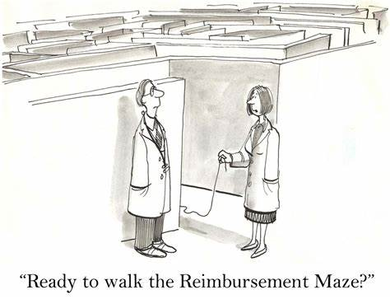
Tip #2 – Learn the basics of billing, coding and reimbursement

Slide 16
Who can get reimbursed for services in medical practices?
Master Level Clinicians
Medicare - LCSW’s only, and only the mental health codes
Medicaid varies by state but may allow: LCSW’s, LCPC’s and LMFT’s, as well as conditional. May aldo vary by practice type.
Commercials may also differ but may restrict to fully licensed staff. May vary re: Health and Behavior codes
Psychologists
Medicare reimburses both mental health and Health and Behavior codes
Paid by Medicaid and Commercial insurers
Psych NP’s/PA’s
Follow rules for E/M codes
Generally paid by all payers
Would not bill Health and Behavior codes

Slide 17
Mental Health and Health and Behavior Codes
Mental Health Codes
Initial Assessment - 90791
Individual Therapy
  90832 – 30 min (16-37) 90834 – 45 min (38-52) 90837 – 60 min (53+)
Family Therapy 90847, 90846, (not less than 26 min.)
90853: Group Therapy
Health and Behavior codes
96150: Assessment
96151: Reassessment
96152:Individual intervention
96153: Group intervention
96154:Family intervention

Slide 18
E/M codes and Psych NP’s
90791, Psychiatric Diagnostic (Dx) Eval.
90792, Psych Dx Eval. with medical services
90791 + 90785, Psych Dx Eval. with interactive complexity
90792 + 90785, Psych Dx Eval. with medical services and interactive complexity
90833, Psychotherapy with E/M, 30 mins (16-37)
90836, Psychotherapy with E/M, 45 mins (38-52)
90838, Psychotherapy with E/M, 60 mins (53 or more)

Slide 19
Evaluation & Management (E&M)
Use E&M codes 99201-99201 or 99211-99215 whenever possible
Services must be medically necessary
Practitioner must be practicing within their scope of practice
Used in conjunction with a medical or psychiatric diagnosis

Slide 20
Medicare reimbursement rates
Type of Provider | % physician fee | Notes
MD/DO, Psychologist | 100% | Or actual charge, whichever is less
PA, NP, CNS | 85%
CSW (LCSW) | 75%
Reduced by any applicable deductible
NHIC website: www.medicarenhiccom on Fee Schedule page.

Slide 21
Medicaid
States have flexibility:
  Covered mental health services
  Two services (mental health and medical) on same day
  Contract with managed care
Billing:
  Requires diagnosis and procedure code
  Some states limit procedures, providers and/or practices that can use these codes

Slide 22

Commercial Insurances – concerns
Credentialing (or enrollment) process and start-up
May respond - too many available clinicians in the area, so won’t allow credentialing
Lack of clarity around covered services
Difficulty finding “experts” to answer specific questions about reimbursement
Carve outs
  Different systems
  Different reimbursement streams
Problems with “prior auth’s” and need for practices to have processes in place
  Who makes the call?
  Which insurances require this?
  How best to set this up in your practice?
  Safety net process

Slide 23

Tip # 3 – Identify the other codes and where to get more information

Slide 24
Health and Behavior Codes
96150 | Assessment | Initial assessment to determine the biological psychological and social factors affecting the physical health and any treatment problems, e.g. health-focused interview
96151 | Re-assessment | Re-assessment to evaluate the condition and determine the need for further treatment. Can be performed by clinician other than the one who did the initial assessment
96152 | Ind Intervention | Service to modify the psychological, behavioral, cognitive and social factors affecting the pt's physical health and well-being, e.g. using CBT
96153 | Grp Intervention | Group sessions typically last 90 minutes and involve 8-10 pts, e.g. Smoking cessation
96154 | Fam Intervent | Service to family with pt. present, e.g. relaxation techniques with diabetic child with parent present

Slide 25
Health & Behavior (H&B) Codes
96150 – 96155
Patient
Underlying physical illness or injury
Biopsychosocial factor may be affecting medical treatment
Physician
Documents need
Assessment
Does not duplicate other assessment
Cognitive capacity for the approach

Slide 26





Examples

Slide 27
Insurance Ramifications
H&B codes:
Covered by some insurers, not all
Discipline reimbursable for some, not all
Medical benefit: No pre-auth, no carve-out, no different co-pay
Medical practice bills
Mental Health codes:
Covered by most insurers
Generally reimbursable
Contract & credentialing with behavioral health carve-out needed
May eventually need pre-auth
May require larger co-pay

Slide 28
Health and Behavior Codes Documentation
  Must include, at a minimum:
  Patient has underlying physical illness or injury
  Biopsychosocial factors affect the treatment of the medical problem
  Evidence that the patient has the capacity to understand or to respond meaningfully
  Clearly defined psychological intervention planned
  Goals of the psychological intervention
  Expectations that the psychological intervention will improve compliance with the medical treatment plan
  The response to the intervention
  Rationale for frequency and duration of services

Slide 29
Crisis Codes 90839 and 90840
Used for urgent assessment and history of crisis state, a mental status exam and disposition.
Includes psychotherapy, mobilization of resources to diffuse crisis and restore safety, and implementation of psychotherapeutic interventions to minimize risk
Typically life threatening, complex and requires immediate attention to a patient in high distress e.g. suicidality, homicidality
Can be coded by DO, MD, APRN, or PA or other qualified health care providers (LSW, LISW, psychology, counselors)
From: Coding and Documentation for Behavioral Health Providers (2016). Diane E. Zucker, M.Ed. CCS-P, Health Care Consultant. Email: dezucker@sbcglobal.net

Slide 30
Crisis Codes 90839 and 90840 - continued
Does not need to be continuous
Full attention of the provider (physician or other qualified health care provider) must be devoted to this patient/family
Patient must be present for some or all of the service
90839 – used for the first 30-74 minutes and can only be coded once per date
90840 - used for each additional block of 30 minutes (not less than 15 minutes)
Do not report in conjunction with 90791, 90792, psychotherapy codes 90832-90838 or other psychiatric services
From: Coding and Documentation for Behavioral Health Providers (2016). Diane E. Zucker, M.Ed. CCS-P, Health Care Consultant. Email: dezucker@sbcglobal.net

Slide 31
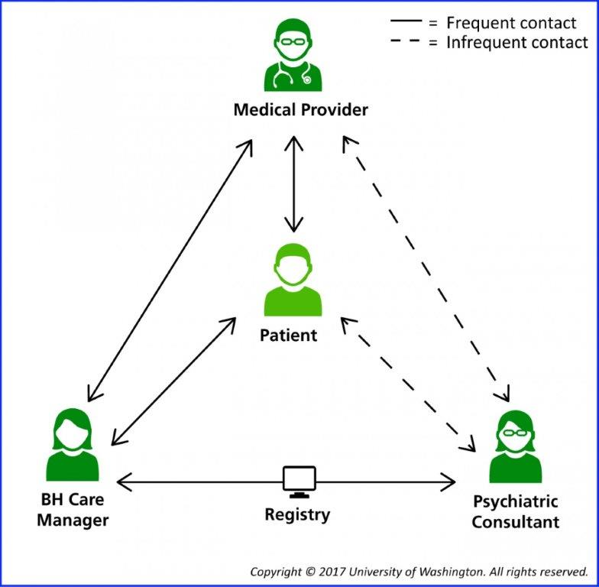
CoCM Team Based Care

Slide 32
Codes and Times
Behavioral Health Integration Coding Summary
BHI Code | Behavioral Health Care Manager or Clinical Staff Threshold Time | Assumed Billing Practitioner Time | Payment/Pt (Non-Fac) Primary Care Settings | Payment/Pt (Fac) Hospitals and Facilities
CoCM First Month (99492) | 70 minutes per calendar month | 30 min | $142.84 | $90.08
CoCM Subsequent Months (99493) | 60 minutes per calendar month | 26 min | $126.33 | $81.11
Add-On CoCM (Any month) (99494) | Each additional 30 minutes per calendar month | 13 min | $66.04 | $43.43
General BHI (99484) | At least 20 minutes per calendar month | 15 min | $47.73 | $32.30
BHI Initiating Visit (AWV, IPPE, TCM or other qualifying E/M) | N/A | Usual work for the visit code | Usual | Usual

Slide 33
References for Collaborative Care Codes
https://aims.uw.edu/collaborative-care/implementation-guide The AIMS Center. University of Washington Psychiatry and Behavioral Sciences
Frequently Asked Questions about Billing Medicare for Behavioral Health Integration (BHI) Services. March 9, 2017
CMS CoCM Fact Sheet: https://www.cms.gov/Medicare/Medicare-Fee-for-Service-Payment/PhysicianFeeSched/Downloads/Behavioral-Health-Integration-Fact-Sheet.pdf
https://www.cms.gov/Medicare/Medicare-Fee-for-Service-Payment/PhysicianFeeSched/
Behavioral Health Integration Services. CMS. Medicare Learning Network. ICN 909432 May 2017.

Slide 34
Other codes to be aware of
Prolonged Evaluation and Management Codes: 99355, 99358, 99359
Interactive Complexity Codes: +90785
Multifamily Group: 90849
Smoking Cessation
Other?.....

Slide 35
Medicare rules: What is a Fiscal Intermediary or MAC and why are they important?
A private health care insurer that has been awarded a geographic jurisdiction to process Medicare Part A and Part B (A/B) medical claims …for Medicare Fee-For-Service (FFS) beneficiaries. CMS relies on a network of MACs to serve as the primary operational contact between the Medicare FFS program and the health care providers enrolled in the program. MACs are multi-state, regional contractor
Functions include:
Process Medicare FFS claims
Make and account for Medicare FFS payments
Enroll providers in the Medicare FFS program
Handle provider reimbursement services and audit institutional provider cost reports
Respond to provider inquiries
Educate providers about Medicare FFS billing requirements
Establish local coverage determinations (LCD’s)
Coordinate with CMS and other FFS contractors
https://www.cms.gov/Research-Statistics-Data-and-Systems/Monitoring-Programs/Medicare-FFS-Compliance-Programs/Review-Contractor-Directory-Interactive-Map/

Slide 36

Tip # 4 – Tie the reimbursement need to the clinical service delivery through good documentation

Slide 37
Mental Health Documents
Initial Assessment
Treatment Plan – within 30 days or 3 sessions. Medicare- not needed for “a few brief sessions”
Progress Notes
Medicare:
Documentation fully supports medical necessity
Providers are exempt from submitting “psychotherapy notes” – defined as “notes recorded…which document or analyze the contents of a counseling session and that are separated from the rest of the medical record”

Slide 38
Initial Assessment 90791
Must include: complete medical including past, family and social
Psychiatric history
Mental Status Exam
Establishment of initial diagnosis
Evaluation of patient’s ability and capacity to respond to treatment
Initial plan of treatment
Can be done:
  At onset of illness
  If a new episode of illness occurs
  After a hiatus
  Or on admission or readmission to an IP setting
Not timed but rather an “event”

Slide 39
The Treatment Plan
Individualized
Must state:
  Type of treatment, e.g. CBT
  Amount of treatment, e.g. 4- 8 sessions
  Frequency of treatment, e.g. every other week
  Duration of services, e.g. 6 months
  Diagnosis
  Anticipated goals and specific objectives
  “Not required if only a few brief services will be furnished” - Medicare

Slide 40
Therapeutic interventions
90832 – 90838 – Individual Therapy - 30 to 60 minutes
  Report actual time spent
90847 and 90846 – Family Therapy – when the primary purpose is the treatment of the patient’s condition
  Can’t be reported for less than 26 minutes
90853 – Group treatment – involving no more than 12 patients. Actual time must be recorded.
  Notes can be similar to Progress Notes, or
  Notes can contain two portions:
    Common language for all patients – key issues presented
    That particular patient’s participation and any significant changes in status

Slide 41
Progress notes
Must include:
Name of patient and date of service
Type of service, e.g. Individual, Family
Time element – exact time
Modalities and frequency of treatment furnished
A note for each encounter that includes: diagnosis, symptoms, functional status, focused MSA, treatment plan, prognosis and progress to date
Identity and credentials of person performing the service

Slide 42

Too much information?
Stop the Madness!

Slide 43

Tip #5 – Organize your information: How about a grid?

Slide 44
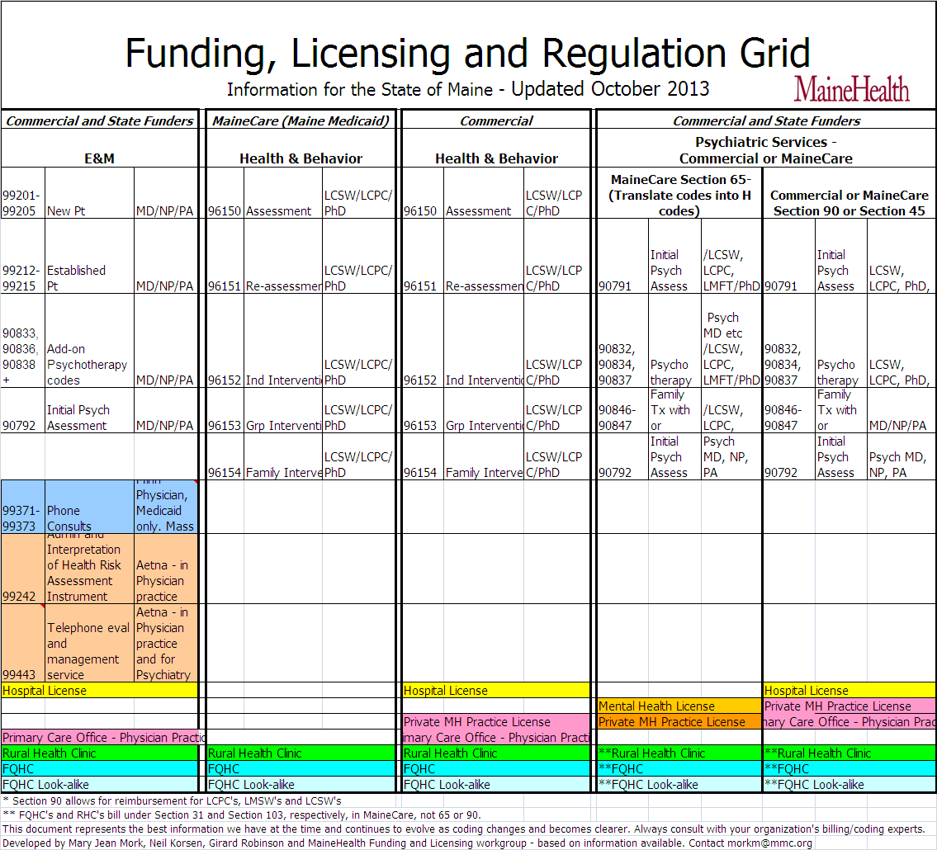

Slide 45
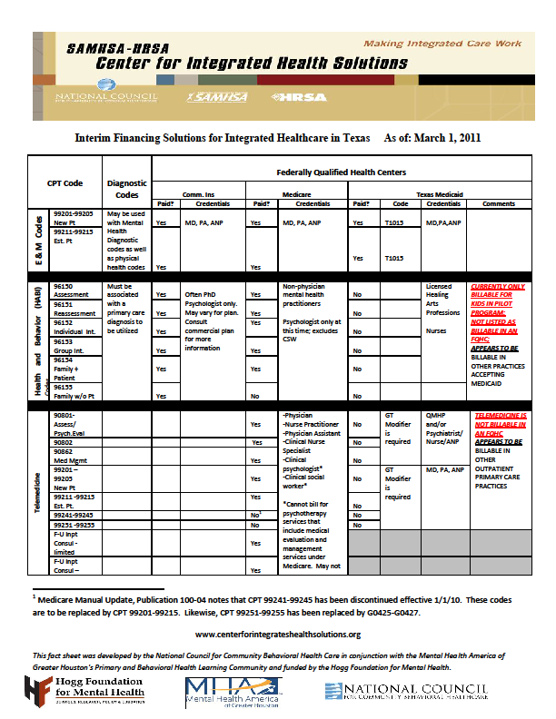

Slide 46
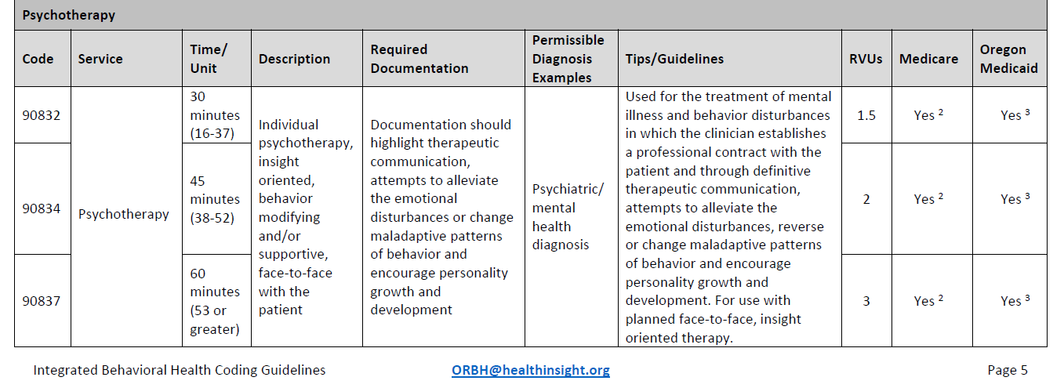

Slide 47
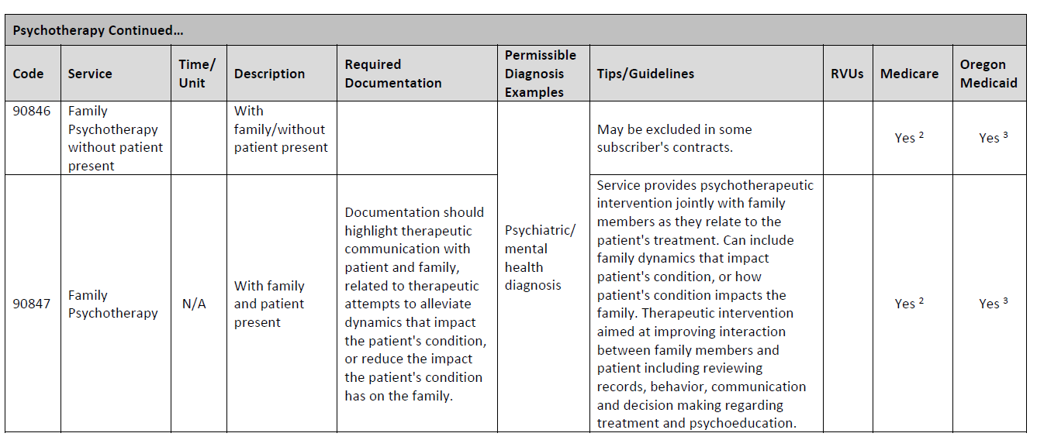

Slide 48
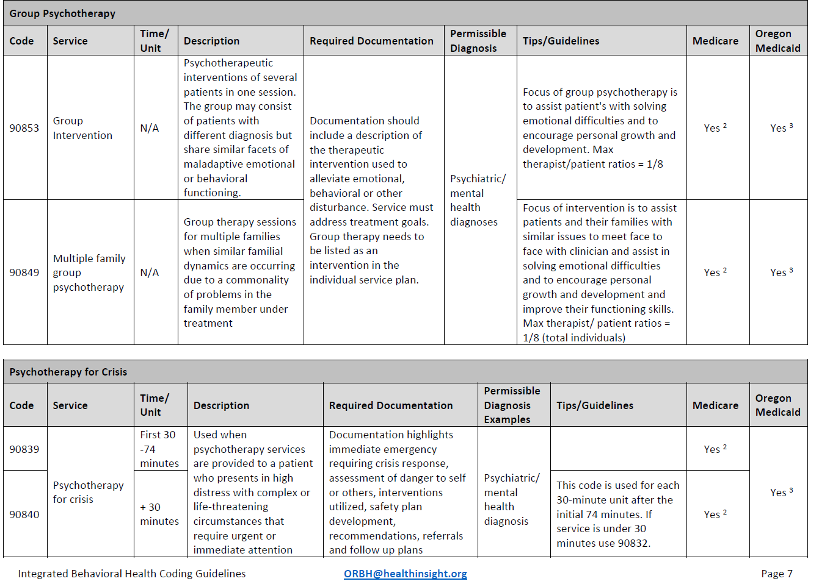

Slide 49
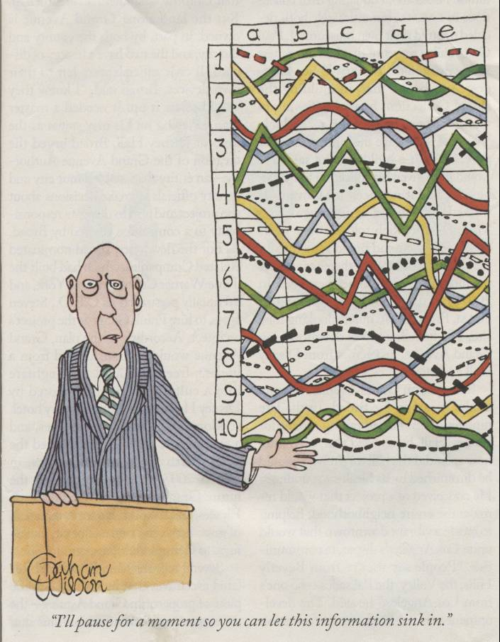

Slide 50

Tip # 6 – Make friends with your billers and coders and anyone else who can help

Slide 51
Who to go to for help
Billing and coding supervisors
Internal auditors
Regional or state-wide integrated policy groups
“People who know what they’re talking about” – where ever you can find them

Slide 52
Work group for reimbursement
Purpose: Sharing information about billing and reimbursement
Process:
  Coming from different perspectives Clarifying, explaining, investigating, and re-clarifying with every piece of new information
  Coming to shared understanding of the present landscape
Identifying areas for change
  Understand the current rules in detail
  Identify opportunities and barriers
  Use your understanding to make recommendations to regarding the most effective way to organize services to maximize reimbursement
  Target the barriers that are highest priority or that we are most likely to be able to change

Slide 53

Tip # 7 – Plan to get paid and evaluate your progress

Slide 54
Plan to get paid
Pre-hire: Clarification of financial and billing arrangements
Hiring Process: Credentialing and preparation for billing
BHC Starts: Orientation of behavioral health provider and preparation for billing
Ongoing Support : Monitoring reimbursement and continuous improvement

Slide 55
Integrated Practice
Start-up Worksheet***
Licensing
Contracts
Credentialing
Registration
Scheduling
First visit
***Request copy: morkm@mmc.org
Subsequent visits
Charge entry
Medical Records
Release of Information

Slide 56
Administrative Team Meeting: the “friendly forum”
Clinicians, provider rep, billers/coders, practice managers, leadership
Data - show rates, referrals, volume: What’s working, not working? Targets?
Payment information: Codes reimbursed/ denied
Communication issues/improvement suggestions: R/t patients, providers, practice
Clinical practice issues: E.g. length of sessions, frequency/duration of treatment

Slide 57
Measuring and Improving
Initial areas of focus: access and productivity
  Volume
  No-shows
  Time to 1st and 3rd
  Charges and collections
  RVU’s
Later areas of focus
  Patient/Provider/staff experience
  Clinical and functional outcomes
  Financial impact

Slide 58
Dashboard example

Slide 59

Tip # 8 – Gather resources and keep learning.
Tip # 9 - Be humble and persistently curious

Slide 60
Other recommendations….
Keep costs down, monitor ongoing financial results and aim for break-even
Investigate and be willing to develop alternative payment models
Acknowledge link between providers and coders. Focus on the front end
Train all staff from the beginning and ongoing
Track the money
Take time with BHC re: coding and documentation
Behavioral health billing requires time, resources and connections to “experts”
Use internal auditor to monitor
  Link to national experts and developing data support for integration

Slide 61
Reimbursement Resources
Medicare Links
http://www.cms.gov/Manuals/IOM/list.asp
http://www.cms.gov/Transmittals/01_overview.asp
Medicare Documentation Guidelines for Evaluation and Managements Services 95 & 97 http://www.cms.gov/MLNEdWebGuide/25_EMDOC.asp
NHIC http://www.medicarenhic.com/
CMS National Correct Coding Initiative
http://www.cms.gov/Medicare/Coding/NationalCorrectCodInitEd/index.html/nationalcorrectcodinited
Other
www.thenationalcouncil.org – the National Council for Community Behavioral Healthcare
www.ibhp.org – Integrated Behavioral Health Project
www.mainehealth.org/mentalhealthintegration
www.cfha.org

Slide 62

Watch for webinars on reimbursement

Slide 63
Resources
SAMHSA Center for Integrated Health Solutions
  Monograph on making the business case, with a spreadsheet that allows calculation of costs and revenues
  Targets CHC’s but applicable to other types of practices
  http://www.integration.samhsa.gov/resource/the-business-case-for-the-integration-of-behavioral-health-and-primary-care
Health Partners Total Cost of Care calculator
    Describes a methodology for measuring total cost of care and resource use
    Includes indexing method that allows comparison across sites
    First TCOC methodology endorsed by National Quality Forum
    https://www.healthpartners.com/public/tcoc/

Slide 64

Tip # 10 – Reframe the question: What is the cost of integration? Or: What is the cost impact of integration?

Slide 65
Finances: Know the questions and the answers
The old question was:
  Can behavioral health integration pay for itself?
The new question is:
  What is the impact of behavioral health integration on health care costs?
Additional questions to ask:
  How well integrated is the practice?
    How long has practice been integrated?
    How much integrated clinician time?
  How well is integration being targeted?

Slide 66
What have others shown?
Intermountain Healthcare article 2010
  Integration reduced ED utilization compared to non-integrated practices by 40-50%
    Reiss-Brennan et al, Journal of Healthcare Management, 2010 March/April; 55(2): 97-114.
Collaborative care for depression
  Initial cost of $580 per patient to implement the model led to decrease in total cost of care of $3300 on average over four years
    Unutzer et al, Long-term cost effects of collaborative care for late-life depression. American Journal of Managed Care. 2008 Feb; 14(2):95-100.

Slide 67
…and comparisons
“Integrated practices” vs. non-integrated practices – Intermountain Healthcare. Report that an investment of $22 PMPY in integrated services decreased medical costs by $115 PMPY. Decrease was in ED and IP utilization. (Reiss-Brennan, et al. JAMA. 2016)
BHC days vs. non-BHC days. On BHC days there was a 42% increase in patient volume of all types resulting in $1,142 more revenue generated (Gouge et al. Southern Medical Journal. 2016)
“Reach” of BHC within clinics (% of panel) indicates that broader reach was connected with overall healthcare savings. (Peterson, et al. Families, Systems and Health. 2017)

Slide 68

Value beyond the $$$ bottom line
Provider satisfaction
Patient satisfaction
Improved access to behavioral health
Improvement in PHQ scores
Improvement in chronic disease indicators
Reduction in unnecessary ED use
Reduction in hospitalization or re-hospitalization
Retention rates for BHC’s
Care coordination for patients with complex needs
And again – PROVIDER SATISFACTION!

Slide 69

Contact:
Mary Jean Mork
VP of Integrated Programming
Maine Behavioral Healthcare, a division of MaineHealth
165 Lancaster Street
Portland, Maine 04101 morkm@mmc.org
207-662-2490
“Start where you are.
Use what you’ve got.
Do what you can.”
Arthur Ashe

