Slide 1
Culturally and Linguistically Appropriate Care
Maria “Chus” Arrojo, LMFT, LMHC
Pediatric Physician’s Organization at Children’s (PPOC)

Slide 2
Pediatric Physician’s Organization at Children’s (PPOC)
The Pediatric Physicians Organization at Children’s (PPOC) is a statewide network of independently owned pediatric practices affiliated with Boston Children’s Hospital, serving more than 350,000 children and adolescents across the Commonwealth.
The PPOC is committed to improving the health and quality of life of all patients in an equitable manner, adhering to Boston Children’s Hospital high quality standards and mission of “Until every child is well”.
To fulfill this mission, the PPOC works diligently to develop strategies and approaches that address the care gaps in the diverse communities we serve.
This work is possible through the ongoing collaboration among the different PPOC programs, Quality Improvement, Patient Safety, Medical Home, Behavioral Health Integration, Interpreter Services, and Regional Support Team.

Slide 3
Overall PPOC Patient Demographics Compared to Massachusetts Population
DEMOGRAPHICS COMPARISON TABLE | PPOC % | MA %
Ethnicity
Not Hispanic/Latino | 88 | 88
Hispanic/Latino | 12 | 12
Race
White | 74 | 77
Asian | 5 | 7
Black/African American | 4 | 8
Other/Multiple | 16 | 8
Insurance Type
Commercial | 69 | 60
Medicaid | 31 | 40
Notes:
The PPOC patient demographics are representative of the Massachusetts population , with a 12% of patients identifying as Hispanic or Latino

Slide 4
Surgeon General Advisory on Protecting Youth Mental Health
Youth at higher risk of mental health challenges during the pandemic include the following:
Racial and ethnic minority youth:
American Indian and Alaska Native youth, many of whom faced challenges staying connected with friends and attending school due to limited internet access
Black youth, who were more likely than other youth to lose a parent or caregiver to COVID
Latino youth, who reported high rates of loneliness and poor or decreased mental health during the pandemic
Asian American, Native Hawaiian, and Pacific Islander youth, who reported increased stress due to COVID-19-related hate and harassment
Youth in immigrant households
Who faced language and technology barriers to accessing health care services and education
Notes:
The surgeon general advisory on youth mental health has identified racial and ethnic “minorities” or “minoritized” youth and youth in immigrant households as two of the categories of youth at higher risk of mental health challenges during the pandemic

Slide 5
Surgeon General Recommendations
Among the surgeon general recommendations:
Build multidisciplinary teams to implement services that are tailored to the needs of children and their families:
Recognize that a variety of cultural and other factors shape whether children and families are able or willing to seek mental health services.
Accordingly, services should be culturally appropriate, offered in multiple languages (including ASL), and delivered by a diverse mental health workforce.
https://www.hhs.gov/sites/default/files/surgeon-general-youth-mental-health-advisory.pdf

Slide 6
PPOC Interpreter Service & CLAS Projects

Slide 7
CLAS Project
HHS defines CLAS (Culturally and Linguistically Appropriate Services) as a way to improve the quality of services provided to all individuals, which will ultimately help reduce health disparities and achieve health equity.
Improve access to language services (Interpreter Service Project)
Assess current Epic data collection and identify opportunities for improvement
Provide providers and practices with education, interventions and experiences guided by national CLAS standards and NCQA guidelines
Improve cultural and linguistic appropriate services provided to patients and demonstrate compliance with CLAS & NCQA standards.
Notes:
CLAS National Standards - blueprint of action steps for health and health care organizations to advance health equity, improve quality, and help eliminate health care disparities
CLAS = Respect + Responsiveness
PPOC CLAS team: a multi-disciplinary group of PPOC staff tasked with providing recommendations and training to meet these goals.

Slide 8
PPOC Regional Support Team (RST)

Slide 9
PPOC Regional Support Team (RST) Overview
The PPOC Regional Support Team is a team of Community Health Workers (CHWs) and a Referral Specialist who provide telephonic and in-person support to PPOC patients and families with a variety of socio-economic, medical, and care coordination needs.
All referrals are initiated by a PPOC provider or practice staff member after completing a Health Needs Assessment (HNA).
Families are handed over the HNA for completion at the time of the child’s annual well child visit. The CHWs can assist families completing the HNA as needed.

Slide 10
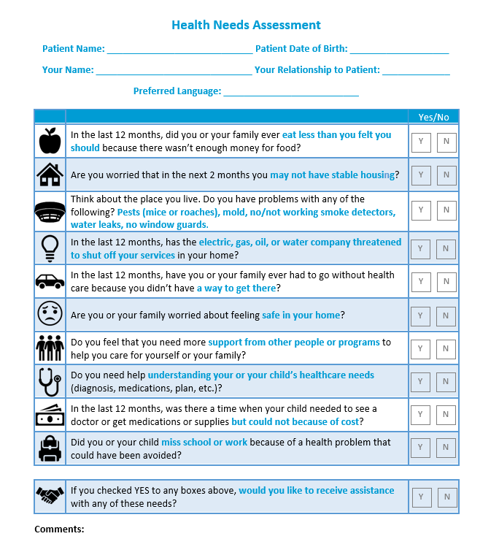
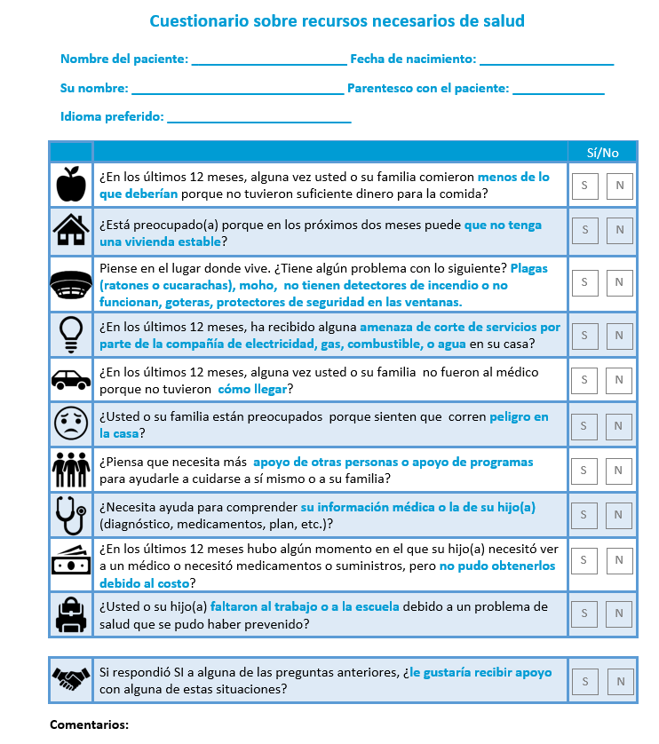
Health Needs Assessment (HNA)
English
Spanish
Adapted from the Health Leads Recommended Screening Tool, www.healthleadsusa.org

Slide 11
Medical Home Asthma Program (MAP)
The Medical Home Asthma Program (MAP) works to help families better manage the child’s asthma, stop their asthma from getting worse, and improve their overall quality of life.
In this free program, Community Health Workers make a series of visits to the home. During those visits they provide asthma education that helps:
Use asthma medications correctly
Follow the child’s asthma action plan
Create an asthma friendly home
Identifying and removing asthma triggers from the home
During these visits, the family is given various supplies based on their environment and need. These supplies may include a HEPA filtered vacuum cleaner, Microfiber cleaning tools, and mattress/pillow encasings that are hypoallergenic and dust mite proof.
Notes:
The next slide is an image we provide the family to explain the program.

Slide 12
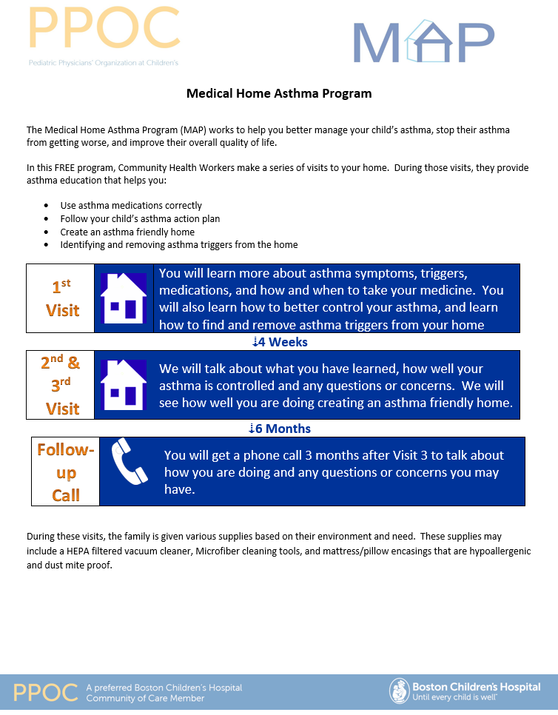
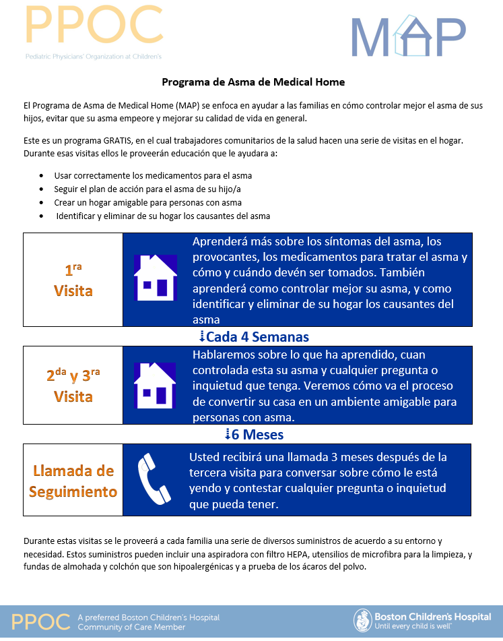
MAP Flyer for Patients & Families
Notes:
We provide it in many different languages
This case-management model provides comprehensive home assessments, mitigates environmental triggers, educates patients and guardians on the proper use of medication, addresses socioeconomic barriers to care, and empowers families to manage their health.

Slide 13
Collaboration with PPOC Behavioral Health Integration Program (BHIP)

Slide 14


Collaboration BHIP – RST
Pathways for collaboration:
BH need identified: PCP BHC RST
Social determinant identified: PCP RST BHC
BHIP team support to RST:
Availability for behavioral health consultations as needed
Participating in multidisciplinary case reviews with the RST
Fostering collaborations with the integrated behavioral health clinicians (BHCs)
Promoting culturally responsive, whole-person care
Supporting practices take patient and family beliefs, values, culture, language, and preferences into consideration
Incorporating relevant content in our educational activities with the practices

Slide 15
Culturally Responsive Care
Helping practices engage in culturally responsive conversations with patients and families:
Assessing how patients are accustomed to participate in their medical treatment.
Proactively and directly addressing socio-economic and cultural factors shaping health beliefs and impacting access to and participation in treatment.
Considering how social determinants mediate perception, cognition, and relationships. And how those affect connectedness, trust, hope, and the ability to influence the environment.
Understanding the impact of stigma and actively working toward de-stigmatization, using culturally appropriate terminology and concepts.
Not making assumptions about the culture of a patient. It is ok to ask the patient to help us understand it.
Using the language of the patient to discuss their health.
Identifying and utilizing cultural strengths to promote the involvement of patients in their own care, and connecting with the patients’ communities.
Openly exploring the role of spirituality and religion in connection with the patients’ views of illness and medical care.
Engaging patients and families in decision making regarding their care, helping them understand their preferences & choices.
Using practice routines transparent to the patient: as much as possible, having conversations about the patient in the presence of the patient and if that is not possible, speaking of the patient as if the patient were present.
Adapted from the core competencies for behavioral health providers working in primary care,

Slide 16
Case examples

Slide 17
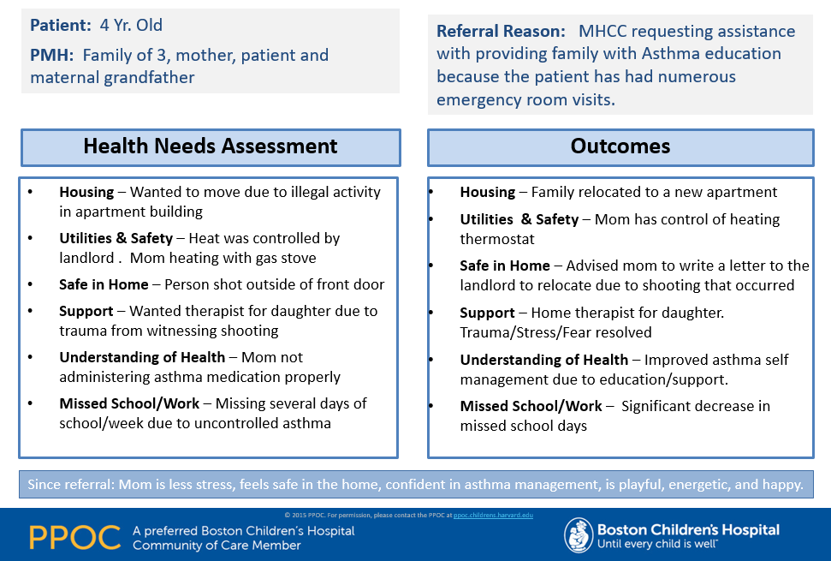
Regional Support Team Case Presentation

Slide 18
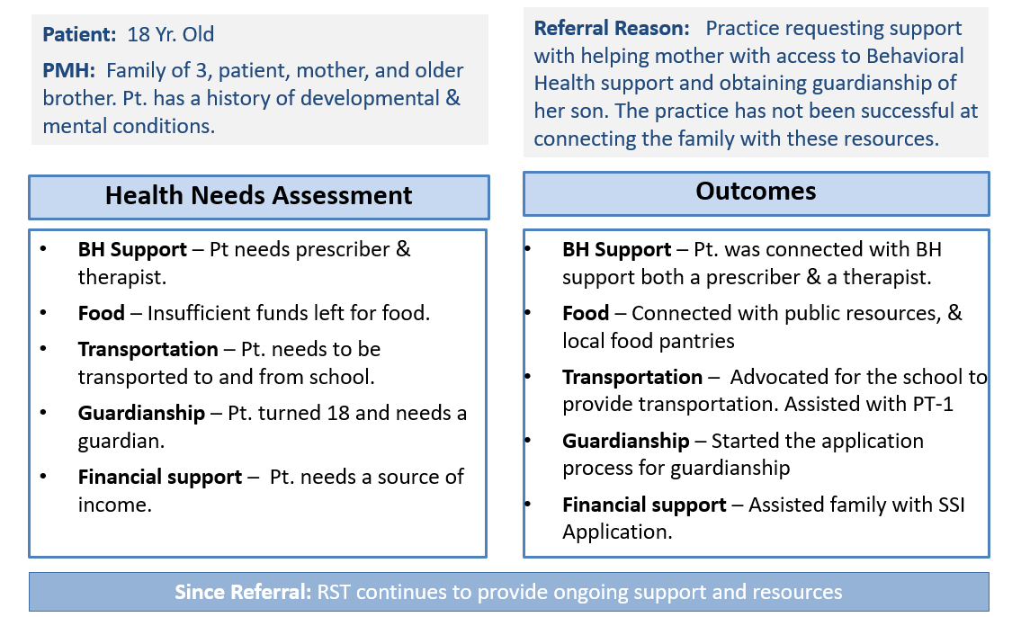
Regional Support Team Case Presentation

Slide 19
THANK YOU!

