Slide 1
How do we best screen for depression and suicide in adolescents? (Kemper et al., 2021)
USPSTF states there is insufficient evidence to universally screen for suicide risk
Universal screening for depression recommended and may help to identify those at risk for suicide
What is the incremental yield of adding suicide screening to depression screening in detecting suicide risk?

Slide 2
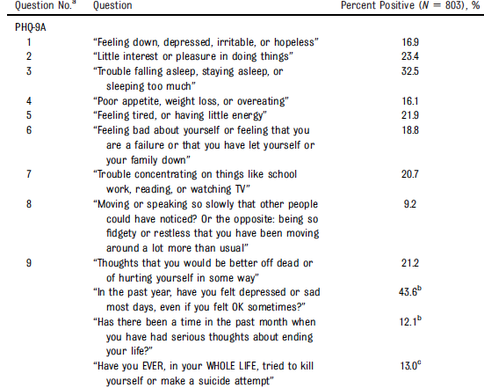
972 adolescents screened with the PHQ-9A and the ASQ across 12 primary care clinics June 2019- October 2020

Slide 3
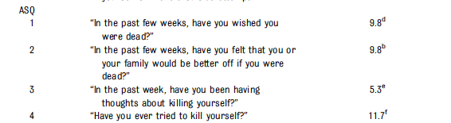
Percent positive

Slide 4
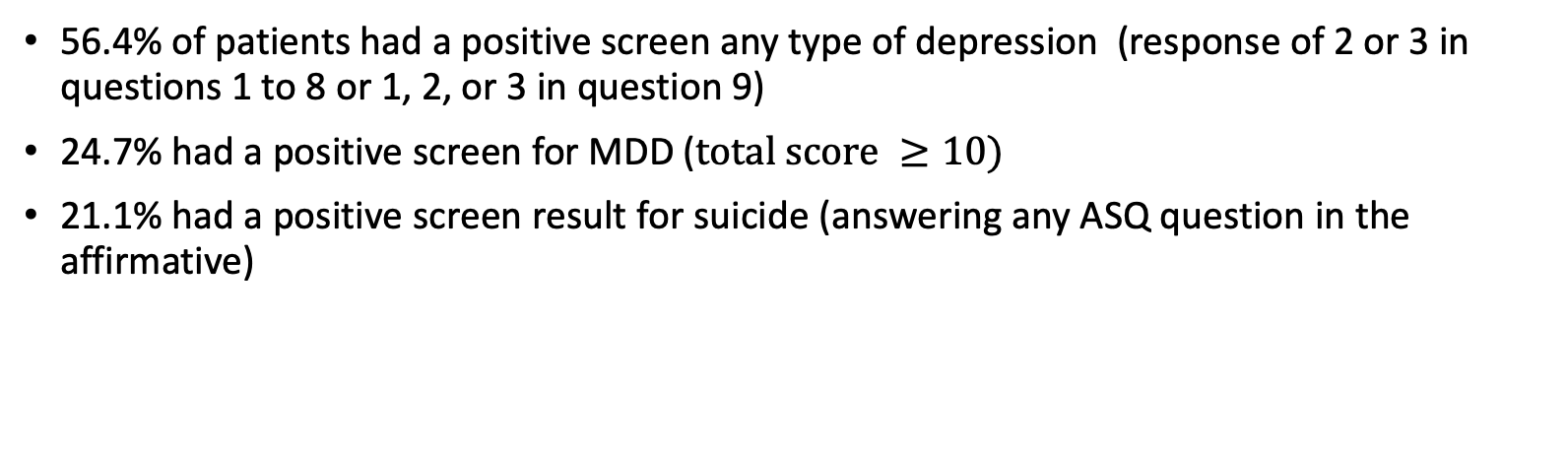
Positive Screens
56.4% of patients had a positive screen any type of depression (response of 2 or 3 in questions 1 to 8 or 1, 2, or 3 in question 9)
24.7% had a positive screen for MDD ($total score ≥10)$
21.1% had a positive screen result for suicide (answering any ASQ question in the affirmative)

Slide 5
Characteristics associated with responses
Proportion for positive screen for any depression decreased with age
Girls more likely than boys to have positive screens for any depression, MDD, and suicide risk
Non-Hispanic Black patients had a lower proportion of positive screen results for suicide
Patients who preferred to speak Somali in the home had a lower proportion of positive screens for any depression, MDD, and suicide risk

Slide 6
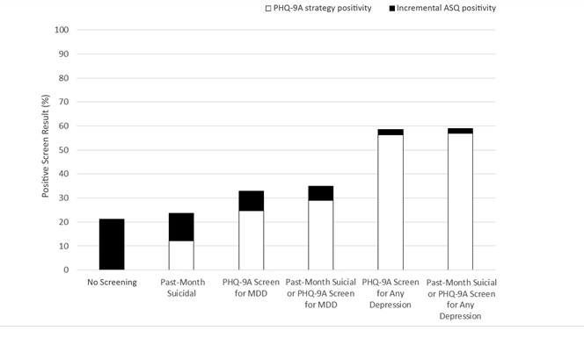

Slide 7
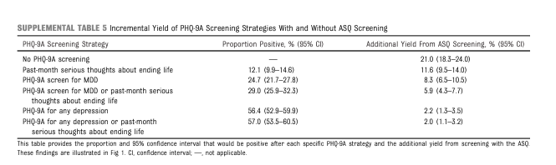

Slide 8
Conclusions
The ASQ identified additional cases of suicide risk above and beyond the PHQ-9A
High percentages of positive screens underscore importance of universal screening + prevention & intervention strategies in primary care
Kemper, A.R., Hostutler, C. A., Beck, K., Fontanella, C. A., Bridge, J. A. (2021). Depression and suicide-risk screening results in pediatric primary care. Pediatrics, 148 (1), e2021049999.

