Slide 1

Perinatal Mental Health:
Screening and Referrals During Pediatric Visits

Slide 2
Brenda Papierniak, PsyD, PMH-C
Ascension Saint Alexius Women & Childrens Hospital
Perinatal & Pediatric Health Psychology Services
Notes:
Introductions slide

Slide 3
Template Guide
A reminder for content slides: Do not allow your text to descend below the line and overlap the Ascension logo. If you need more room for text, use Title and Content Option 2 in the template.
Session Goals and Disclosures
Overview:
This presentation will provide medical providers, social workers, case managers with a basic understanding of how to and why to assess for perinatal mood & anxiety disorders (PMADs) in new parents in pediatric care settings. Resources for further understanding tools available will be provided at the end of this presentation.
Goals:
Be able to identify symptoms of PMADs.
Be able to understand basic screening and scoring using the EPDS.
Have increased language to provide psychoeducation to other providers and family members interacting with families who are struggling with PMADs.
Disclosures: I have no conflicts of interest or financial disclosures

Slide 4

Why screen?
15-20% of women can experience postpartum depression or anxiety symptoms.
40% of postpartum deaths are related to mental health or substance abuse concerns
Mother’s wellness is IMPORTANT!!! For her and her family.
Without treatment, postpartum depression can last for months or years.
In addition to affecting the mother’s health, it can interfere with her ability to connect with and care for her baby. It may cause the baby to have problems with sleeping, eating, and behavior as s/he grows.
Perinatal Mood & Anxiety disorders are treatable.
As providers, you can reduce the stigma around this disorder by asking, supporting, and referring to trained professionals

Slide 5

Paternal depression/anxiety facts:
Prevalence: 8 - 13% of new fathers report experiencing postpartum depression
Highest risk at 3-6 months postpartum
American Academy of Pediatrics recommends implementing universal PMAD screenings in pediatric treatment settings (primary care, NICU, ED, etc).
Can negatively impact attachment and social/emotional development for children
Can impact relationship with their partner, children
Can impact development, behaviors, mental health of children
Early identification can lead to improved caregiver MH outcomes

Slide 6
Things to consider with screening:
Perinatal mood & anxiety disorders are the number one complication in pregnancy and the postpartum period.
The American Academy of Pediatrics (AAP) recommends that pediatricians screen mothers for postpartum depression (PPD) at the infant's 1, 2, 4, and 6-month well child (WC) visits. Despite these recommendations, less than 50% of mothers are screened nationally.
Not all states mandate for screening during pregnancy or postpartum. Often in Pediatric settings parents are seen as separate from their infants or there is concern about how to document screening/risk of parents in their pediatric charts.
US is not doing well when it comes to screening/treating for PMADs. https://www.2020mom.org/state-report-cards

Slide 7

Why do parents avoid screenings or share limited information regarding how they are feeling?
Don’t understand importance for their child, fear of judgement, fear of being reported to DCFS, cultural considerations
How to discuss screenings and encourage parents to be honest with completing them. Important to normalize and decrease worry.

Slide 8

Who needs to screen?
Nationwide debate
The “silo mentality” of medicine
Who is the patient?
Who pays?
Insurance and referrals?
Pediatricians? OBs/Midwives? LCs? Doulas?
What about moms with babies in NICU?
Higher risk of PMADs

Slide 9

OB’s
Mom’s treatment provider
However, OBs see moms during pregnancy at birth, not again until 6 weeks postpartum
Moms are not likely to reach out
2018 - American College of Obstetricians and Gynecologists (ACOG) Committee:
"To optimize the health of women and infants, postpartum care should become an ongoing process, rather than a single encounter, with services and support tailored to each woman's individual needs.”

Slide 10
Pediatricians
See moms more often after delivery and ongoing for the first year
Standardized postpartum depression (PPD) screening and use of a referral algorithm can be effective in the ambulatory pediatric setting, according to research presented at the National Association of Pediatric Nurse Practitioners' 39th National Conference on Pediatric Health Care
Concerns:
Mom is not the client and who pays to screen
What do we do if mom isn’t doing well?

Slide 11

Supporting Families in Pediatric Primary Care Centers
Pediatric providers are able to recognize, screen, and address parental depression even beyond the postpartum period. They will be the medical providers to see the family most frequently in the postpartum period.
Studies have shown that family involvement in pediatric care is linked with positive health outcomes for children
Primary care providers have the ability to focus on the parent/child relationship and overall family health. This allows for better health outcomes for their pediatric patients.

Slide 12
Edinburgh Postpartum Depression Scale (EPDS)
EPDS most commonly referenced screening tool. Has been validated to be used during pregnancy and in the postpartum period, up to 12 months (for both birthing and non birthing parents)
Consists of 10 questions - looking at the previous 7 days.
Scoring = highest score possible is a 30 - recommended cutoff score of 11 to avoid false negatives
0 - no depression/anxiety indicated 1 - 6 minimal depression 7 - 13 mild depression 14 - 19 moderate depression 19 - 30 severe depression
EPDS has been translated into a number of languages. 18 validated translations and another 18 non validated translations. (see link)
https://www.mcpapformoms.org/Docs/Edinburgh%20Depression%20Scale%20Translated%20Government%20of%20Western%20Australia%20Department%20of%20Health.pdf

Slide 13
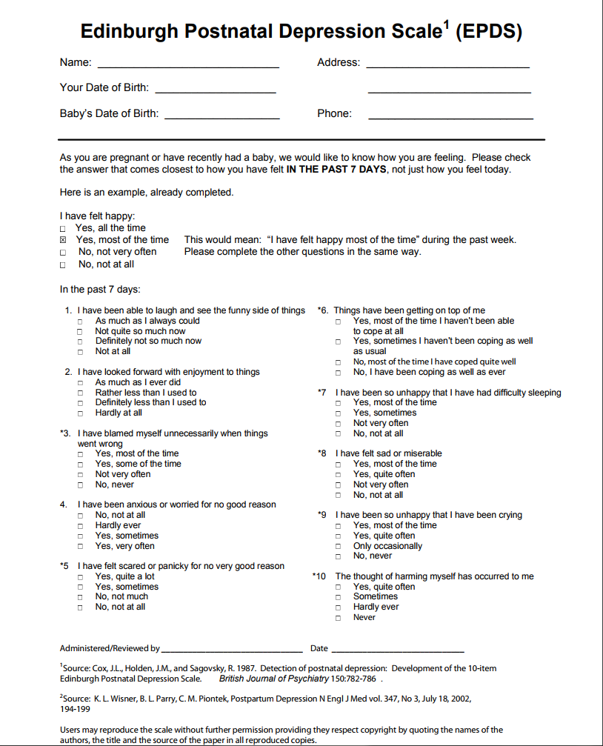
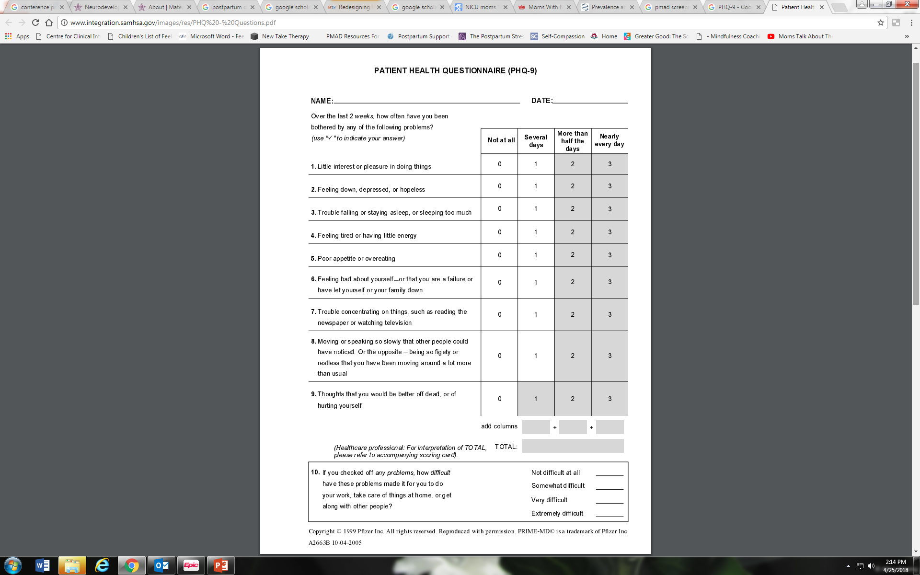
Screening for PMADS
Two most popular screens are the PHQ-9 and the Edinburgh Postnatal Depression Scale

Slide 14
Other Screening Tools
Depression
Patient Health Questionnaire PHQ-2 (2 questions) or the PHQ-9 (9 questions) This screener is also validated for use in the general population, including the perinatal period.)
Anxiety and Anxiety-Related Disorders
Perinatal Anxiety Screening Scale (PASS) (31 questions)
Edinburgh Postnatal/Perinatal Depression Screen (EPDS) (1 question, Q4 & Q5) (Validated for use in pregnancy and in the postpartum period.)
GAD-2 (2 questions) or GAD-7 (7 questions) (Validated for use in the general population.)
Beck Depression Inventory (BDI)

Slide 15
Other screening tools continued:
Perceived Prenatal Maternal Stress Scale (PPNMSS) Measures prenatal maternal stress (PNMS), assists with screening for stress and depression among pregnant women.
PTSD Primary Care -PTSD-5 (PC-PTSD-5) (5 questions)
Bipolar Disorder Mood Disorder Questionnaire (MDQ) (17 questions)
Psychosis a person experiencing psychosis may be incapable of completing a symptom screening questionnaire directly due to breaks in reality; therefore family/supports are often the first to notice behavior changes. The following psychosis symptom checklist (PSC) and overview can be used by providers and family/supports to determine if psychosis may exist. Policy Center for Maternal Mental Health's Psychosis Symptom Checklist (PSC)
Substance Use Disorder National Institutes of Health Screening and Assessment Tools Chart
Birth Equity, Social Determinants of Health screenings

Slide 16

Once screened, then what?
A negative screen still requires check-in with family.
A positive screen indicates further assessment is needed, preferably by a mental health clinician trained in PMAD treatment
Follow up with moms
Frequently do not manage own care or follow up with mental health providers
Image by Erin McPhee

Slide 17
Psychoeducation
Difference between Baby Blues and a PMAD
Signs and symptoms of depression
Signs and symptoms of anxiety
Talk about self-care, coping skills, healthy eating, sleeping, using supports
Talking about the intrusive thoughts

Slide 18

Effective treatment options
Medication
Individual therapy / Group Therapy
Psychoeducation
Support system development
CBT, ACT, Interpersonal Therapy, mindfulness based practices, etc
Self-compassion work
Couples therapy
Complementary and Alternative Medicine
Self-care

Slide 19
Psychotropic Medications
Medications can be a big help for some moms – important to find a provider who understands PMADs. The risk of meds may be less than the risk of not treating sx.
The LactMed Database, a free online database maintained by the National Library of Medicine in the US, is a wonderful online resource for information on breastfeeding and medications.
https://toxnet.nlm.nih.gov/newtoxnet/lactmed.htm
Mother to Baby has an “Ask the Expert” option
https://mothertobaby.org/
Infant Risk Center – safety of meds during pregnancy and breastfeeding
https://www.infantrisk.com/

Slide 20
National support for moms
Postpartum Support International
Warmline: 1-800-944-4773(4PPD)
Or Text: 503-894-9453
Online Support Groups
Postpartum Support International: postpartum.net
National Suicide Prevention Hotline: 1-800-273-8255
National Maternal Mental Health Hotline (see flier)

Slide 21


Slide 22
Resources
2020 Mom. (2022, March). Universal Screening for Maternal Mental Health Disorders [Issue Brief]. https://www.2020mom.org/issue-briefs-and-papers
https://www.2020mom.org/state-report-cards
https://med.stanford.edu/content/dam/sm/ppc/documents/DBP/EDPS_text_added.pdf
Screening for Perinatal Depression – ACOG. (2016, October 29). from https://www.acog.org/Resources-And-Publications/Committee-Opinions/Committee-on-Obstetric-Practice/Screening-for-Perinatal-Depression

Slide 23

Resources Continued:
https://www.postpartum.net/get-help/
https://postpartumhealthalliance.org
https://www.marchofdimes.org
https://www.nichd.nih.gov/ncmhep/initiatives/moms-mental-health-matters/find-help
https://www.postpartumstress.com/perinatal-mood-and-anxiety-disorders
https://www.womenshealth.gov/mental-health/mental-health-conditions/postpartum-depression

Slide 24
References
Kurtz, S., Levine, J., & Safyer, M. (2017). Ask the question: Screening for postpartum mood and anxiety disorders in pediatric primary care. Current Problems in Pediatric and Adolescent Health Care, 47 (10), 241 - 253. https://doi.org/10.1016/j.cppeds.2017.08.002
Hunt, A. M., Porter, S., & Jimenez, E. M. (2022). Parental depression screening in pediatric health care settings: A scoping review. Pediatrics, 155 (1). https://doi.org10.1542/peds.2021-055804
Laudato, N., Yagiela, L., Eggly, S., & Meert, L. K. (2020). Understanding parents' informational needs in the pediatric intensive care unit: A qualitative study. Progress in Pediatric Cardiology, 57(1). https://doi.org/10.1016/j.ppedcard.2019.101172
Lenore, J., Beers, L., Theodorou, P., Hoffman, S. B., Long, M., Soghier, L., & Fratantoni, K. (2019). Perinatal mood and anxiety disorder screening: Integrating care across settings. Pediatrics, 144(2), 60. https://doi.org/10.1542/peds.144.2MA1.60
Lenore, J., Long, M., Theodorou, P., Hoffman, S. B., Soghier, L., & Beers, L. (2021). Perinatal mental health task force: Integrating care across a pediatric hospital setting. Pediatrics, 148(6), 1 - 7. https://doi.org/10.1542/peds.2021-050300
Perazzo, S. I., Jarvis, L. R., Israel, S., Lee, M.C., Koozmin, A. L., Okito, O., Sadler, E. M., Keegan, R., & Soghier, L. (2022). Perinatal mood anxiety disorders (PMAD) screening in the neonatal intensive care unit (NICU) and the pediatric emergency department (ED). Pediatrics, 149 (1), 72.

Slide 25

References continued:
Richard, J., Shepherd, J., Boyles, C. E., Marsh, M. J., Thomas, P.W., Ross, O.C. (2012). Evaluation and comparison of parental needs, stressors, and coping strategies in a pediatric intensive care unit. Pediatric Critical Care Medicine, 13 (3), 166 - 172. https://doi.org/10.1097/PCC.0b013e31823893ad
Screening for Perinatal Depression – ACOG. (2016, October 29). from https://www.acog.org/Resources-And-Publications/Committee-Opinions/Committee-on-Obstetric-Practice/Screening-for-Perinatal-Depression
Stefana A, Padovani EM, Biban P, Lavelli M. Fathers’ experiences with their preterm babies admitted to neonatal intensive care unit: a multi-method study. J Adv Nurs. 2018;74:1090–8. https://doi.org/10.1111/jan.13527
Stone, J., & Allen, L. (2021). Increasing Postpartum Depression Screening in the Pediatric Setting. Carolina Journal of Interdisciplinary Medicine, 1(1), 43 – 52. https://doi.org/10.47265/cjim.v1i1.539

Slide 26
Questions?
Brenda Papierniak, PsyD, PMH-C
Perinatal and Pediatric Health Psychology Services
224-299-5660
Brenda.Papierniak@Ascension.org
Notes:
Personal info 5
Intro 5
Video 8
Programs 7
Questions 10

Slide 27
Programs and Resources offered at Ascension
Pregnancy and Postpartum Mood & Anxiety Disorder Program
Perinatal & Pediatric Health Psychology Program
Perinatal Intensive Outpatient Program (IOP)
Support Groups
Consultations
Perinatal Mental Health Certification (PMH-C)

