Slide 1
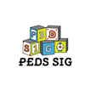
Family psychosocial risk screening guided by
the Pediatric Psychosocial Preventative
Health Model(PPPHM) using the
Psychosocial Assessment Tool (PAT)
Research Corner
3/4/2024
Kazak, A. E., Schneider, S., Didonato, S., & Pai, A. L. (2015). Family psychosocial risk
screening guided by the Pediatric Psychosocial Preventative Health Model (PPPHM)
using the Psychosocial Assessment Tool (PAT). Acta Oncologica, 54(5), 574–580.
https://doi.org/10.3109/0284186X.2014.995774

Slide 2
Background
While the psychosocial needs of families with children facing life threatening pediatric illnesses are well-documented, effectively identifying these needs and providing evidence-based care remains a challenge.
Systematically screening for various family psychosocial risks can effectively identify treatment needs for patients and families.
Kazak, A. E., Schneider, S., Didonato, S., & Pai, A. L. (2015). Family psychosocial risk
screening guided by the Pediatric Psychosocial Preventative Health Model (PPPHM)
using the Psychosocial Assessment Tool (PAT). Acta Oncologica, 54(5), 574–580.
https://doi.org/10.3109/0284186X.2014.995774

Slide 3
Method
The Pediatric Psychosocial Preventative Health Model (PPPHM):
Figure 1. Pediatric Psychosocial Preventative Health Model (PPPHM).
Kazak, A. E., Schneider, S., Didonato, S., & Pai, A. L. (2015). Family psychosocial risk
screening guided by the Pediatric Psychosocial Preventative Health Model (PPPHM)
using the Psychosocial Assessment Tool (PAT). Acta Oncologica, 54(5), 574–580.
https://doi.org/10.3109/0284186X.2014.995774
Notes:
The PPPHM (Figure 1) is based on a public health framework and used to conceptualize families with varying levels of psychosocial risk along with interventions matched to risk.
At the base of the pyramid are Universal families, who are concerned or distressed about their child’s health problems, but who are generally resilient and able to cope and adapt to their child’s illness and treatment.
Provide psychoeducation and family-centered support
Screen for indicators of higher risk
The middle tier consists of Targeted families, with pre-existing concerns or difficulties that may contribute to continuing or escalating vulnerability during treatment.
Monitor child/family distress and risk factors
Provide interventions specific to symptoms or adherence needs
At the tip of the pyramid are Clinical/Treatment families, with one or more pre-existing, chronic, and complex problems and resulting greatest need for prompt and often intensive intervention.
Consult behavioral health specialist
Intensify psychosocial services
Address impact on the medical treatment

Slide 4
Method
The Psychosocial Assessment Tool (PAT):
A brief (5-10 minutes) parent report screener of psychosocial risk for use in pediatrics
Response format(s): Yes/No, Likert ratings, fill-in-the-blank questions, checkboxes
Number of items varies depending on the age of child and of siblings (if any) and also the version used (e.g. adaptations for different diseases may result in additional items):
demographic characteristics, diagnosis, family structure, family resources, social support, child knowledge of disease, school enrollment, school placement, child problems (internalizing, externalizing, social, cognitive), sibling problems, family problems, family beliefs, and stress responses.
Has been used for families across a broad range of age, from infants to adolescents.
Has been translated and validated into many languages for use in the United States and internationally.
Can be administered via a web-based format or REDCap, but also paper and pencil format.
Kazak, A. E., Schneider, S., Didonato, S., & Pai, A. L. (2015). Family psychosocial risk
screening guided by the Pediatric Psychosocial Preventative Health Model (PPPHM)
using the Psychosocial Assessment Tool (PAT). Acta Oncologica, 54(5), 574–580.
https://doi.org/10.3109/0284186X.2014.995774
Notes:
Sample items include “Tell us who lives in the child’s home” (Family Structure), “Tell us about who helps out with the child’s care” (Social Support), “At any times during the child’s illness have you lost interest in being with family and friends, or doing regular activities as a result of the illness?” (Stress Reactions), and “As a caregiver for the child, how much do you believe the doctors and nurses will know how to help?” (Family Beliefs).

Slide 5
Results
The PAT is a validated measure of psychosocial risk.
Internal consistency = .81
Two-week test-retest reliability among mothers (r =.78) and fathers (r =87).
Significantly correlated with measures of acute stress and child behavior symptoms (Pai et al., 2008).
Scores on the PAT, derived from multiple sites and disease conditions, mapped onto the PPPHM:
15% of families scored in the Clinical/Treatment tier
25% to 33% of families scored in the Targeted tier
50% to 66% of families scored in the Universal tier
Kazak, A. E., Schneider, S., Didonato, S., & Pai, A. L. (2015). Family psychosocial risk
screening guided by the Pediatric Psychosocial Preventative Health Model (PPPHM)
using the Psychosocial Assessment Tool (PAT). Acta Oncologica, 54(5), 574–580.
https://doi.org/10.3109/0284186X.2014.995774
Notes:
The PAT was developed originally from The Children’s Hospital of Philadelphia (CHOP), then other independent research on the PAT came from five other major children’s oncology centers in Australia [10], Canada [11], The Netherlands [12] and the US (Mississippi [13], Georgia [14]).
Reliability and validity: alpha =.81; test re-test reliability over 2-week period rs=.78-.87. Scores correlated with acute stress and child behavior symptoms as reported by both mothers and fathers.

Slide 6
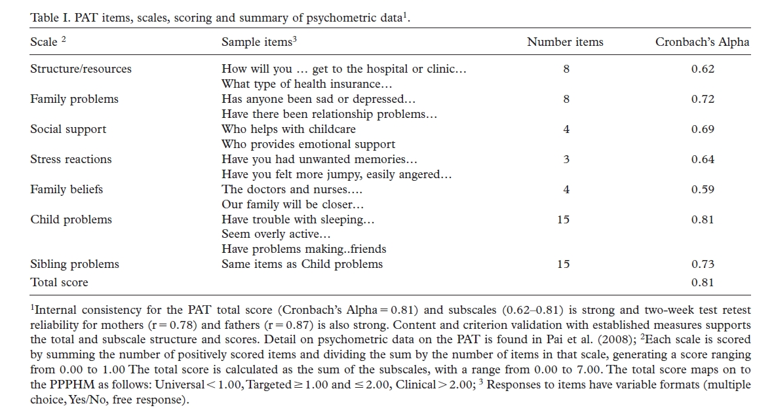
Results
Kazak, A. E., Schneider, S., Didonato, S., & Pai, A. L. (2015). Family psychosocial risk
screening guided by the Pediatric Psychosocial Preventative Health Model (PPPHM)
using the Psychosocial Assessment Tool (PAT). Acta Oncologica, 54(5), 574–580.
https://doi.org/10.3109/0284186X.2014.995774
Notes:
The PAT was developed originally from The Children’s Hospital of Philadelphia (CHOP), then other independent research on the PAT came from five other major children’s oncology centers in Australia [10], Canada [11], The Netherlands [12] and the US (Mississippi [13], Georgia [14]).
Reliability and validity: alpha =.81; test re-test reliability over 2-week period rs=.78-.87. Scores correlated with acute stress and child behavior symptoms as reported by both mothers and fathers.
Content validity: significant correlations of Child Problems with BASC-2 Behavioral Symptoms Index; Total scores correlate highly with measures of distress and poorer family functioning.
As of 2018, the PAT is currently used in approximately 29% of pediatric cancer programs in the United States (Scialla et al., 2018).

Slide 7
Conclusion
Screening is the first step to assure psychosocial risks and resiliencies of families are detected early on in the course of care.
The PAT was found to be a brief and validated measure of psychosocial risk, available in various formats and languages.
PAT scores, and its corresponding links to PPPHM tiers (e.g. Universal, Targeted, Clinical/Treatment), can provide direction for the delivery of evidence-based psychosocial care.
Kazak, A. E., Schneider, S., Didonato, S., & Pai, A. L. (2015). Family psychosocial risk
screening guided by the Pediatric Psychosocial Preventative Health Model (PPPHM)
using the Psychosocial Assessment Tool (PAT). Acta Oncologica, 54(5), 574–580.
https://doi.org/10.3109/0284186X.2014.995774

