Slide 1
A systematic review of pediatric primary care screening measures
Classification accuracy was measured by sensitivity and specificity
Classification Accuracy of Behavioral Screening Measures for Pediatric Integrated Primary
Care Settings
Lavigne, J. V., Meyers, K. M., & Feldman, M. (2016). Systematic review: Classification accuracy of behavioral screening measures for use in integrated primary care settings. Journal of Pediatric Psychology, 41(10), 1091–1109. doi:10.1093/jpepsy/jsw049

Slide 2
Searched across three databases:
Ovid Medline, Embase, and PsycINFO
Search terms included:
Screening, primary care, behavior problems, emotional problems, psychopathology, behavioral screening, children, and adolescents
Also, conducted some additional supplementary searches to capture other screeners: CAT, DIAMOND, and PROMIS
Classification accuracy was measured by:
Sensitivity – the percent of individuals with a disorder who are correctly identified (true positives)
Specificity – the percent of individuals without a disorder correctly identified (true negatives)
Method

Slide 3
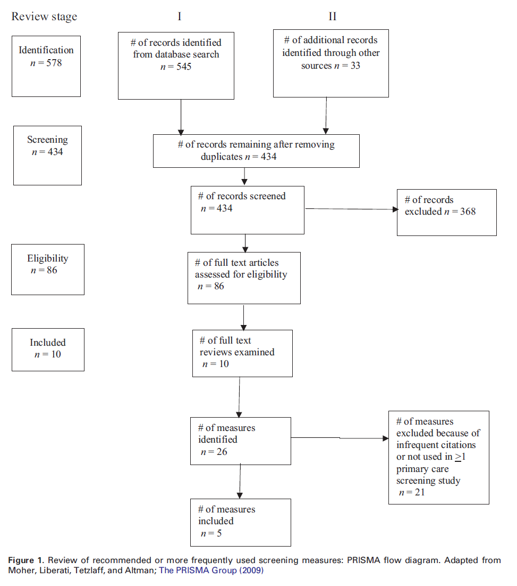
Method

Slide 4
Child Behavior Checklist (CBCL)
113-item parent-report measure for children aged 6–18
Pediatric Symptom Checklist (PSC)
35-item parent-report scale for children aged 4 years and above
Strengths and Difficulties Questionnaire (SDQ)
25-item parent-report questionnaire for youth aged 3–16 years
Brief Infant-Toddler Social Emotional Assessment (BITSEA)
31-item parent-report measure for children aged 1–3 years
Ages and Stages Questionnaire: Social-Emotional scale (ASQ:SE)
19-33 item parent-report measure for children between 6 months to 60 months
Other screeners (e.g., CAT, DIAMOND, and PROMIS)
Method

Slide 5
Child Behavior Checklist (CBCL)
Met (> .70) sensitivity and specificity criterion: 50%
Widely used, but tended to not be effective in identifying high sensitivity and specificity simultaneously
Strengths and Difficulties Questionnaire (SDQ)
Met (> .70) sensitivity and specificity criterion: 30.8%
Few studies found high sensitivity and specificity
Brief Infant-Toddler Social Emotional Assessment (BITSEA)
Met (> .70) sensitivity and specificity criterion: 85.7%
High sensitivity and specificity, but few studies
Ages and Stages Questionnaire: Social-Emotional scale (ASQ:SE)
Met (> .70) sensitivity and specificity criterion: 100%
High sensitivity and specificity, but with few studies, and some limitations
Results

Slide 6
Pediatric Symptom Checklist (PSC)
Met (> .70) sensitivity and specificity criterion: 55.6%
High sensitivity and specificity
Pediatric Symptom Checklist-17 (PSC-17)
Also, high sensitivity and specificity, but with some limitations
Other screeners:
CAT of PSC
High sensitivity and specificity, but with some limitations
DIAMOND
Promising sensitivity and specificity, but with some limitations
PROMIS
Classification accuracy has not been examined
Results

Slide 7
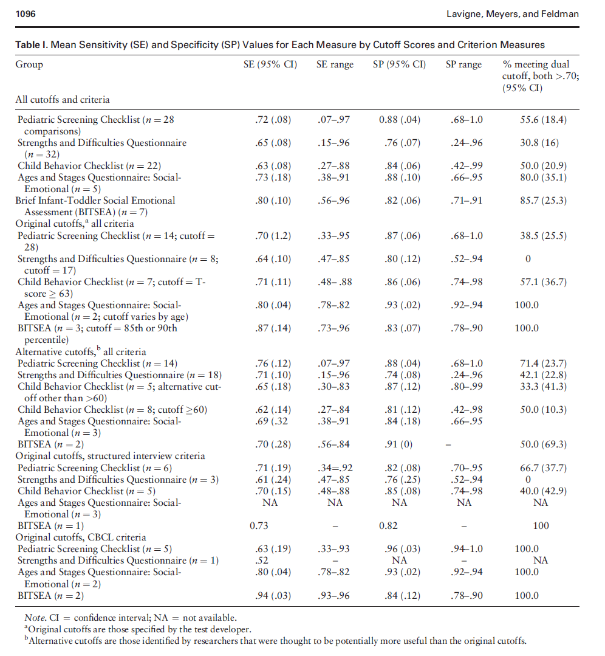
Results

Slide 8
The CBCL, SDQ, and PSC were most popular, however only met (> 70) sensitivity and specificity criterion: 30.8–55.6%
There were relatively few studies of the ASQ:SE and BITSEA, and/or of relatively new measures
Results

Slide 9
Takeaways:
Achieving high sensitivity and specificity was found to be inconsistent across studies, therefore, it is difficult to suggest one measure over another at this time
A number of other clinical and practical considerations will play an important role in developing a screening process that is useful and can be maintained over time
Discussion

Slide 10
Screening measure recommendations:
Should not require special training to administer
Should require less than 15 min to complete
Should be available in the public domain (no cost)
Should carefully consider the purpose of the screening process to decide what sensitivity and specificity values are acceptable
Discussion

Slide 11
What screening measures do you use?
Discussion

